Slide 1
Data Parallelism and Control-Flow
Unit 1.c

Slide 2
Acknowledgments
Authored by
  Thomas Ball, MSR Redmond

Slide 3
Recall Parallel.For
A
A;
Parallel.For(0, N,
m: i => { B; }
);
C;
…
m(0)
m(1)
m(N-1)
C

Slide 4
Control Flow: When Ordering Matters
In theory, no order between the delegates m(i)
  Parallel.For expresses potential maximal parallelism
In practice, ordering/sequencing of m(i) impacts performance
  cache locality
  dynamic partitioning, load balancing
Programmers also may need control over execution
  stop, break, exception handling, cancellation

Slide 5
Concepts
Workloads
Static and dynamic partitioning
Coordination vs. computation
Partitioner
Local control-flow
Stop/break out of Parallel.For
Exceptions
Cancellation
Performance
Concept
Code
Concept

Slide 6
Parallel.For on Two Cores, an Unbalanced Workload, a Static Partition

Slide 7
Work and Span
Parallelism = Work/Span
Unbalanced workload + static partition
  Work unchanged
  Static partition increases Span
  Parallelism decreases
What to do?
  Ensure a balanced workload, or
  Dynamically partition work (can also increase Span, but not as much as before)

Slide 8
Partitioning
Less Load-Balancing
Less Coordination
More Coordination
Notes:
See Parallel.For examples

Slide 9
Coordination vs. Computation in the Parallel DAG
Coordination
  Work done by the run-time to properly schedule m(i)
  Each edge has a run-time cost (burden)
Computation
  The execution of A, m(i), C
A
…
m(0)
m(1)
m(N-1)
C

Slide 10
Ordering of Iteration Space and Partitioning
Parallel.For(0,N, …)
  Ordered by integer range [0...N-1]
Parallel.ForEach(enumerable, …)
  Ordered by integer range if enumerable is
    Array
    IList<T>
  Otherwise,
    ordered by enumerable.Current/MoveNext

Slide 11
Dynamic Partitioning via Chunking
A chunk is a contiguous range of iteration space
  chunk is executed by one task sequentially
  more computation/less coordination
Parallel.For dynamically allocates chunks to tasks
Chunk size increases over time
  ensures good load balancing if few iterations
  minimizes overhead if there are many iterations
Notes:
Toub says: Parallel.For’s algorithm is actually more complicated than this in order to make better use of cache locality while minimizing synchronization. It starts by dividing the iteration space up into P ranges, and every work item <= P that joins into the loop will be assigned its own range. Within each range, chunking happens. This way, threads are largely operating on their own region of the iteration space, but their grabbing chunks from it rather than reserving the whole thing, such that if another worker completes its range, or if an additional worker > P arrives, that worker will be able to help finish the initially assigned range (with the exception of whatever is in the most recently allocated chunk from that range). So, your description on the slide is accurate, but there’s more going on beyond what you’ve listed in order to improve perf and minimize synchronization on the same memory locations (since each range ends up having its own “next available” index marker).

Slide 12
System.Collections.Concurrent.Partitioner
// Represents a particular manner of splitting a
// data source into multiple partitions.
public abstract class Partitioner<TSource>
{
protected Partitioner();
public virtual bool SupportsDynamicPartitions { get; }
public virtual IEnumerable<TSource> GetDynamicPartitions();
public abstract IList<IEnumerator<TSource>>
GetPartitions(int partitionCount);
}
public abstract class OrderablePartitioner<TSource> :
Partitioner<TSource>
Notes:
Partitioner<T> is what allows you to supply custom partitioning, Partitioner<T> hands out enumerators for each partition, and as Partitioner<T> works with arbitrary Ts rather than just Int32 or Int64, Parallel.ForEach has overloads that accept Partitioner<T> but Parallel.For does not. If you do want to partition an integral range through your own custom mechanism, you can create a Partition<Int32> or Partitioner<Int64> to do whatever you want… you then just use Parallel.ForEach with it instead of Parallel.For.

Slide 13
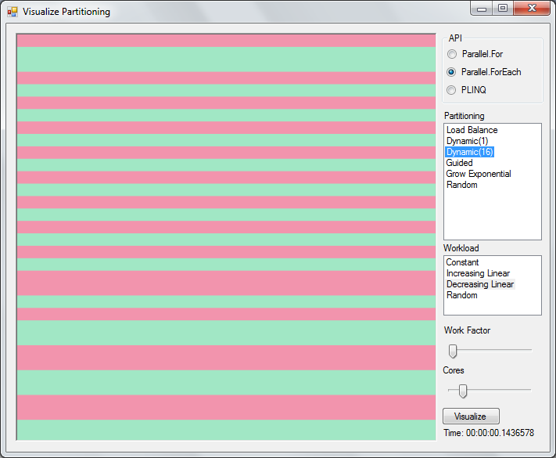
Visual Partitioning:
Explore Workloads and Partitioning

Slide 14
Take Advantage of Chunking via Local Control Flow

Slide 15
π in Parallel, Very Inefficiently
const int NUM_STEPS = 100000000;
static double NaiveParallelPi()
{
double sum = 0.0;
double step = 1.0 / (double)NUM_STEPS;
object obj = new object();
Parallel.For(0, NUM_STEPS, i =>
{
double x = (i + 0.5) * step;
double partial = 4.0 / (1.0 + x * x);
lock (obj) sum += partial;
});
return step * sum;
}

Slide 16
Local Control-flow
public static ParallelLoopResult For<TLocal>(
int fromInclusive, int toExclusive,
Func<TLocal> localInit,
Func<int, ParallelLoopState, TLocal, TLocal> body,
Action<TLocal> localEnd);
…
localInit
localInit
Sequential
Task Chunks
body
body
…
…
body
body
localEnd
localEnd
Notes:
http://msdn.microsoft.com/en-us/library/dd460703(v=VS.100).aspx
The body delegate is invoked once for each value in the iteration range: [fromInclusive, toExclusive). It is provided with the following parameters: the iteration count (an Int32), a ParallelLoopState instance that may be used to break out of the loop prematurely, and some local state that may be shared amongst iterations that execute on the same thread.
The localInit delegate is invoked once for each thread that participates in the loop's execution and returns the initial local state for each of those threads. These initial states are passed to the first body invocations on each thread. Then, every subsequent body invocation returns a possibly modified state value that is passed to the next body invocation. Finally, the last body invocation on each thread returns a state value that is passed to the localFinally delegate. The localFinally delegate is invoked once per thread to perform a final action on each thread's local state. This delegate might be invoked concurrently on multiple threads; therefore, you must synchronize access to any shared variables.
If fromInclusive is greater than or equal to toExclusive, then the method returns immediately without performing any iterations.

Slide 17

π in Parallel, More Efficiently
const int NUM_STEPS = 100000000;
static double ParallelPi()
{
double sum = 0.0;
double step = 1.0 / (double)NUM_STEPS;
object obj = new object();
Parallel.For(0, NUM_STEPS,
() => 0.0,
(i, state, partial) =>
{
double x = (i + 0.5) * step;
return partial + 4.0 / (1.0 + x * x);
},
partial => { lock (obj) sum += partial; });
return step * sum;
}
Alpaca
Project
ControlFlow\LocalControlFlow.cs

Slide 18
More Control Flow
Stop/break out of Parallel.For
Parallel execution and exceptions
Cancelling a parallel computation

Slide 19
Stopping Parallel For Loops
Example 1
  Searching a large unsorted collection
  First hit wins
Example 2
  Searching a large unsorted collection
  Find lowest index with matching element

Slide 20
ParallelLoopState
Enables iterations of Parallel loops to interact with other iterations
  One instance provided by runtime to each loop
  Methods
    void Stop()
    void Break()

Slide 21
Searching for 42
int index = -1;
ParallelLoopResult loopResult =
Parallel.For(0, a.Length,
  (int i, ParallelLoopState loop) =>
  {
  if (a[i] == 42)
  {
  index = i;
  loop.Stop();
  }
  }
);
if (!loopResult.IsCompleted) {
Console.WriteLine(“42 at index ” + index);
}
Alpaca
Project
ControlFlow\StopBreak.cs
Notes:
Race condition on exit (above is non-deterministic)

Slide 22
Searching for First 42
ParallelLoopResult loopResult =
Parallel.For(0, a.Length,
(int i, ParallelLoopState loop) =>
    {
    if (a[i] == 42)
    {
    loop.Break();
    }
    }
);
if (loopResult.LowestBreakIteration.HasValue) {
Console.WriteLine(“Lowest index of 42 = ” +
loopResult.LowestBreakIteration.Value);
}

Slide 23
Long Running Loop Iterations
Poll ParallelLoopState
  bool IsStopped
  Nullable<long> LowestBreakIteration
  bool IsExceptional
  bool ShouldExitCurrentIteration

Slide 24
ParallelLoopResult
IsCompleted == true
  All iterations were processed.
IsCompleted == false && LowestBreakIteration.HasValue == false
  Stop was used to exit the loop early
IsCompleted == false && LowestBreakIteration.HasValue == true
  Break was used to exit the loop early,

Slide 25
What does this code do?
try {
Parallel.Invoke(
  () => { int x = 0; int y = 100/x; },
  () => { object p = null; var s = p.ToString(); }
  );
} catch (Exception e) {
Console.WriteLine(e.ToString());
}

Slide 26
System.AggregateException
Used to consolidate multiple failures into a single, throwable exception object
AggregateException
  ReadOnlyCollection<Exception> InnerExceptions
  AggregateException Flatten()
  void Handle(Func<Exception, bool> pred)
Alpaca
Project
ControlFlow\AggregateExceptionExample.cs

Slide 27
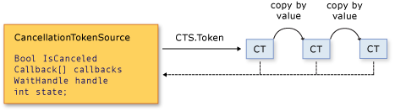
Cancellation in .NET 4
CancellationTokenSource
CancellationToken

Slide 28
Cancellation in .NET 4
Cancellation is cooperative
Listeners can be notified of cancellation requests by
  polling, callback registration, or waiting on wait handles
A cancellation request is sent to all copies of the token via one method call
A listener can listen to multiple tokens simultaneously by joining them into one linked token

Slide 29
void Cancel()
The associated CancellationToken will transition to a state where IsCancellationRequested returns true.
Any callbacks or cancelable operations registered with the CancellationToken will be executed.
Cancelable operations and callbacks registered with the token should not throw exceptions.

Slide 30
Canceling Parallel.For (1)
var cts = new CancellationTokenSource();
var po = new ParallelOptions()
{
CancellationToken = cts.Token,
MaxDegreeOfParallelism =
System.Environment.ProcessorCount,
};
Alpaca
Project
ControlFlow\CancelingExample.cs

Slide 31
Canceling Parallel.For (2)
Parallel.Invoke(
() =>
{
Thread.Sleep(10);
Console.WriteLine("Cancelling operation via CancellationToken.Cancel...");
cts.Cancel();
},
() =>
{
try
{
Thread.Sleep(1);
int[] nums = Enumerable.Range(0, 1000000).ToArray();
Parallel.ForEach(nums, po, (num) =>
{
double d = Math.Sqrt(num) * Math.Sqrt(num * num);
});
Console.WriteLine("Operation completed without being cancelled.");
}
catch (OperationCanceledException e)
{
Console.WriteLine(e.Message);
Assert.IsTrue(token.IsCancellationRequested);
}
});

Slide 32
Multiple Exit Strategies
Unhandled exceptions take priority over Stop, Break, or cancellation requests
If no exceptions occurred but the CancellationToken was signaled and either Stop or Break was used
  there’s a potential race as to whether the loop will notice the cancellation prior to exiting:
  If it does, the loop will exit with an OperationCanceledException.
  If it doesn’t, it will exit due to the Stop/Break

Slide 33
Multiple Exit Strategies
Stop and Break may not be used together. If they are, an exception will be raised.
For long running iterations, there are multiple properties an iteration might want to check to see whether it should bail early:
  IsStopped, LowestBreakIteration, IsExceptional
  ShouldExitCurrentIteration property, which consolidates all of those checks in an efficient manner.
Notes:
ShouldExitCurrentIteration also incorporates a cancellation check.

Slide 34
http://code.msdn.microsoft.com/ParExtSamples
ParallelExtensionsExtras.csproj
  Extensions/
    AggregateExceptionExtensions.cs
    CancellationTokenExtensions.cs
  Partitioners/

