Slide 1
Imperative Data Parallelism (Performance)
Unit 1.a

Slide 2
Acknowledgments
Authored by
Thomas Ball, MSR Redmond
This slide deck contains material courtesy of
Tim Harris, MSR Cambridge

Slide 3
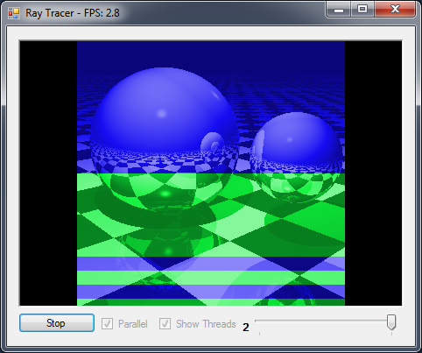
Data Intensive Problems
Rendering in 3D
Ray tracing
Modeling of complex physical systems
Weather prediction
Analysis of massive datasets
Web search

Slide 4
Data Parallelism
Why: speed-up
How (greatly simplified):
split work into independent similar pieces
execute pieces in parallel
collect results
Simple example
Count number of words in a set of files

Slide 5
Concepts
Amdahl’s law
Directed-acyclic graph (DAG) execution model
Work and span
C# lambdas
Parallel.For
Happens-before edges
Performance
Concept
Code
Concept
Correctness
Concept

Slide 6
Amdahl’s law
Sorting takes 70% of the execution time of a sequential program
You replace the sorting algorithm with one that scales perfectly on multi-core hardware
How many cores do you need to get a 4x speed-up on the program?
Notes:
Tim Harris

Slide 7
Amdahl’s law, $f=70\%$
$$Speedup\left(f,c\right)= \frac{1}{\left(1−f\right)+\frac{f}{c}}$$
$f$ | = the parallel portion of execution
$$\left(1−f\right)$$ | = the sequential portion of execution
$$c$$ | = number of cores used

Slide 8
Amdahl’s law, $f=70\%$
Desired 4x speedup
Speedup achieved (perfect scaling on 70%)

Slide 9
Amdahl’s law, $f=70\%$
Desired 4x speedup
Limit as c→∞ = 1/(1-f) = 3.33
Speedup achieved (perfect scaling on 70%)

Slide 10
Amdahl’s law, $f=10\%$
Amdahl’s law limit, just 1.11x
Speedup achieved with perfect scaling

Slide 11
Amdahl’s law, $f=98\%$

Slide 12
Lesson
Speedup is limited by sequential code
Even a small percentage of sequential code can greatly limit potential speedup

Slide 13
On The Sunny Side of the Street: Gustafson’s Law
Any sufficiently large problem can be parallelized effectively
$$Speedup\left(f,c\right)=fc+\left(1−f\right)$$
$f$ | = the parallel portion of execution
$$\left(1−f\right)$$ | = the sequential portion of execution
$$c$$ | = number of cores used
Key assumption: $f$increases as problem size increases

Slide 14
Sequential Merge Sort
16MB input (32-bit integers)
Time
Recurse(left)
Sequential
Execution
Recurse(right)
Merge to scratch array
Copy back to input array

Slide 15
Parallel Merge Sort (as Parallel Directed Acyclic Graph)
16MB input (32-bit integers)
Time
Recurse(left)
Recurse(right)
Parallel
Execution
Merge to scratch array
Copy back to input array

Slide 16
Parallel DAG for Merge Sort (2-core)
Sequential Sort
Merge
Sequential Sort
Time

Slide 17
Parallel DAG for Merge Sort (4-core)

Slide 18
Parallel DAG for Merge Sort (8-core)

Slide 19
Work and Span
Work
the total number of operations executed by a computation
Span
the longest chain of sequential dependencies (critical path) in the parallel DAG

Slide 20
T∞ (span): Critical Path Length (Sequential Bottleneck)
$$T_{∞}= O(n)$$

Slide 21
T₁ (work): Time to Run Sequentially
$$T_{1}= O(n\log{n})$$

Slide 22
Work $T_{1}$, S$pan T_{∞}$, and Running Time $T_{P}$
$T_{P}$ = time to run on P processors
Work Law
$$\frac{T_{1}}{P}≤T_{P}$$
“speedup is limited by P”

Slide 23
Work $T_{1}$, S$pan T_{∞}$, and Running Time $T_{P}$
$T_{P}$ = time to run on P processors
$$\frac{T_{1}}{T_{P}}≤P$$
Speedup

Slide 24
Work $T_{1}$, S$pan T_{∞}$, and Running Time $T_{P}$
$T_{P}$ = time to run on P processors
Span Law
$$T_{∞}≤T_{P}$$
“speedup also is limited by critical path”

Slide 25
Work $T_{1}$, S$pan T_{∞}$, and Running Time $T_{P}$
$T_{P}$ = time to run on P processors
$$\frac{T_{1}}{T_{P}}≤ \frac{T_{1}}{T_{∞}}$$
Speedup
Parallelism
“speedup is bounded above
by available parallelism”

Slide 26
Work/Span of Merge Sort (Sequential Merge)
Work $T_{1}$ : $O\left(n\log{n}\right)$
Span $T_{∞}$ : $O\left(n\right)$
Takes $O\left(n\right)$ time to merge $n$elements
Parallelism:
$\frac{T_{1}}{T_{∞}}$: $O\left(\log{n}\right)$ - really bad!

Slide 27
Main Message
Analyze the Work and Span of your algorithm
Parallelism is Work/Span
Try to decrease Span
the critical path
a sequential bottleneck
If you increase Span
better increase Work by a lot more!

Slide 28
And Now, For Something Completely Different
λx.x
Alpaca
Project
LambdasAndDelegates.cs

Slide 29
C# Lambda Expressions
Syntax
(input parameters) => expression
(input parameters) => {statement;}
Examples:
x => x
(x,y) => x==y
(int x, string s) => s.Length > x
() => { return SomeMethod()+1; }
Func<int, bool> myFunc = x => x == 5;
bool result = myFunc(4);
Notes:
http://msdn.microsoft.com/en-us/library/bb397687.aspx

Slide 30
Some Useful Delegate Types
delegate void Action()
Action showMethod = () => WriteLine(“Hi!”);
delegate void Action<T>(T t)
Action<int> showPlusOne = (x) => WriteLine(x+1);
delegate U Func<T,U>(T t)
Func<int,int> plusOne = (x) => (x+1);

Slide 31
Things to Know about C# Lambdas
Lambda is an expression (with no type)
Its “signature” is inferred by the compiler by what it’s being assigned to.
Conversion to a delegate type
Type inference for parameters
Capture of free variables
Locations referenced by free variables are converted to be on the heap (“boxed”)
Notes:
The general rules for lambdas are as follows:
* The lambda must contain the same number of parameters as the delegate type.
* Each input parameter in the lambda must be implicitly convertible to its corresponding delegate parameter.
* The return value of the lambda (if any) must be implicitly convertible to the delegate's return type.
Note that lambda expressions in themselves do not have a type because the common type system has no intrinsic concept of "lambda expression." However, it is sometimes convenient to speak informally of the "type" of a lambda expression. In these cases the type refers to the delegate type or Expression type to which the lambda expression is converted.
The following rules apply to variable scope in lambda expressions:
- A variable that is captured will not be garbage-collected until the delegate that references it goes out of scope.
- Variables introduced within a lambda expression are not visible in the outer method.
- A lambda expression cannot directly capture a ref or out parameter from an enclosing method.
- A return statement in a lambda expression does not cause the enclosing method to return.
- A lambda expression cannot contain a goto statement, break statement, or continue statement whose target is outside the body or in the body of a contained anonymous function.

Slide 32
Parallel.For
public static ParallelLoopResult For(
int fromInclusive
, int toExclusive
, Action<int> body
);
Alpaca
Project
ParallelSamples.cs
PoPP_ClosingOverSharedData.cs

Slide 33
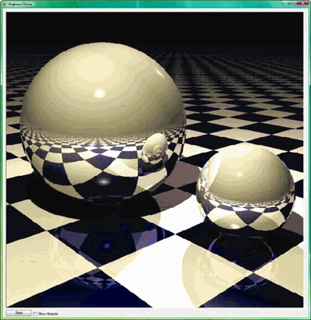
Sequential Ray Tracing
void Render(Scene scene, Color[,] rgb)
{
for (int y = 0; y < screenHeight; y++)
{
for (int x = 0; x < screenWidth; x++) {
rgb[x,y] = TraceRay(new Ray(scene,x,y));
}
}
}

Slide 34
Parallel Ray Tracing with Lambda and Parallel.For
void Render(Scene scene, Color[,] rgb)
{
Parallel.For(0, screenHeight, (y) =>
{
for (int x = 0; x < screenWidth; x++)
{
rgb[x,y] = TraceRay(new Ray(scene,x,y));
}
});
}
Run It!
Alpaca
Project
RayTracerTest.cs
ValidateOutput_BasicParallelRaytracer
Notes:
For(Int32, Int32, Action<Int32>)

Slide 35
Thinking About Parallel.For

Slide 36
Parallel DAG Edges (Happens-before) Constrain Execution
X
Implementation guarantees
X completes execution before Y starts execution
All effects of X are visible to Y
No directed path between X,Y, no guarantees
X,Y could happen in parallel, or
X could happen before Y, or
Y could happen before X
Y
X
Y
Correctness
Concept
Notes:
transitivity

Slide 37
Parallel.For Happens-before Edges
A;
Parallel.For(0, N, m: i => { B; });
C;
A
…
m(0)
m(1)
m(N-1)
C
Notes:
Each iteration in parallel (in the limit)
But we can make no assumptions about the degree of parallel execution
Structured control flow via fork-join pattern
all pieces start at same time
wait until all pieces are done
parallel tasks should execute in isolation
communication limited to fork, join

Slide 38
What .NET 4 Does For You
Parallel.For automatically
Assigns work to cores efficiently
Dynamically partitions
Balances load efficiently
Handles exceptions
And much more…
Notes:
When a parallel loop runs, the TPL partitions the data source so that the loop can operate on multiple parts concurrently. Behind the scenes, the Task Scheduler partitions the task based on system resources and workload. When possible, the scheduler redistributes work among multiple threads and processors if the workload becomes unbalanced.

Slide 39
Example Partitioning on Two Cores
Notes:
Dynamic partitioning won’t give this result

Slide 40
Partitioning on Four Cores

Slide 41
Unbalanced Workloads

Slide 42
Parallel.For(0, N, i => { S });
Desirable properties of statement S
S does enough work, or
N is large enough to compensate

Slide 43
Some Typical Reasons for Performance Problems
Not enough work per parallel task
Overhead of coordinating parallelism dominates
Insufficient memory bandwidth
Limitation of processor architecture
False sharing
Bad cache performance
Exposed to memory wall
Lock contention

Slide 44
Nested Parallel.For
void Render(Scene scene, Color[,] rgb)
{
Parallel.For(0, screenHeight, (y) =>
{
Parallel.For(0, screenWidth, (x) =>
{
rgb[x,y] = TraceRay(new Ray(scene,x,y));
}
});
}
Is there enough work per parallel task? Experiment and find out!
Alpaca
Project
FineVsCoarseGrainedRayTracer.cs
RayTracerTest.cs

Slide 45
http://code.msdn.microsoft.com/ParExtSamples
Parallel.For/ForEach
Game of Life
Blend Images
ImageColorizer
Morph
MandelbrotsFractals
ComputePi
Strassens

Slide 46
Parallel Programming with Microsoft .NET
Chapter 1 (Introduction)
Chapter 2 (Parallel Loops) Parallel.For/ForEach

