Slide 1
Practical Parallel and Concurrent Programming
Course Overview
http://ppcp.codeplex.com/

Slide 2
These Course Materials Brought to You By
Microsoft Research (MSR)
Research in Software Engineering (RiSE)
University of Utah
Computer Science
With support from
MSR External Research (Judith Bishop)
Microsoft Parallel Computing Platform (Stephen Toub, Sherif Mahmoud, Chris Dern)

Slide 3
Courseware Authors
Thomas Ball, MSR Redmond
Sebastian Burckhardt, MSR Redmond
Ganesh Gopalakrishnan, Univ. Utah
Joseph Mayo, Univ. Utah
Madan Musuvathi, MSR Redmond
Shaz Qadeer, MSR Redmond
Caitlin Sadowski, Univ. California Santa Cruz

Slide 4
Acknowledgments
This slide deck contains material courtesy of
Tim Harris, MSR Cambridge
Burton Smith, MSR Redmond
The headshot of the alpaca used throughout the lectures is licensed under
the Creative Commons Attribution-Share Alike 2.0 Generic license
http://en.wikipedia.org/wiki/File:Alpaca_headshot.jpg

Slide 5
Overview
Context
Trends
Applications
System and environment
Concepts
Units, Materials and Tools

Slide 6
Technology Trends
Increasing parallelism in a “computer”
multi-core CPU
graphical processing unit (GPU)
cloud computing
Increasing disk capacity
we are awash in interesting data
data-intensive problems require parallel processing

Slide 7
Technology Trends (2)
Increasing networks and network bandwidth
wireless, wimax, 3G, …
collection/delivery of massive datasets, plus
real-time responsiveness to asynchronous events
Increasing number and variety of computers
smaller and smaller, and cheaper to build
generating streams of asynchronous events

Slide 8
Parallelism and Concurrrency: System and Environment
Parallelism: exploit system resources to speed up computation
Concurrency: respond quickly/properly to events
from the environment
from other parts of system
Environment
Events
System

Slide 9
Application Areas
Entertainment/games
Finance
Science
Modeling of real-world
Health care
Telecommunication
Data processing
…

Slide 10
Discuss application areas in context of
Trends
Parallelism/Concurrency
System/Environment

Slide 11
Practical Parallel and Concurrent Programming (PP&CP)
P&C | Parallelism | Concurrency
Performance | Speedup | Responsiveness
Correctness | Atomicity, Determinism, Deadlock, Livelock, Linearizability, Data races, …
P&C

Slide 12
Overview
Context
Concepts
Multi-core computer
Speedup
Responsiveness
Correctness
Units, Materials and Tools

Slide 13
Concept #1: System = Multi-core Hardware

Slide 14
What is Today’s Multi-core?
What is the architecture?
What are its properties?
Computation
Communication
Delivery guarantees
Latency
Throughput
Consistency
Caching

Slide 15
A simple microprocessor model ~ 1985
Processor core
Clock: 0
Clock: 1
Clock: 2
Clock: 3
Clock: 4
Clock: 5
Clock: 6
Clock: 7
Clock: 8
Clock: 9
Clock: 10
Clock: 11
Clock: 12
ALU
Single h/w thread
Instructions execute one after the other
Memory access time ~ clock cycle time
1
Instruction stream
2
Completion time
2
4
3
6
4
9
5
12
...
Main memory
ALU: arithmetic logic unit

Slide 16
FastFwd Two Decades (circa 2005): Power Hungry Superscalar with Caches
Multiple levels of cache, 2 cycles for L1, 20 cycles for L2, 200 cycles for memory
ALU
ALU
ALU
Instruction stream
Completion time
Dynamic out-of-order
Pipelined memory accesses
Speculation
1
2
2
2
L1 cache (64KB)
3
2
4
204 (main memory)
L2 cache (4MB)
5
226 (hit in L2)
...
Main memory

Slide 17
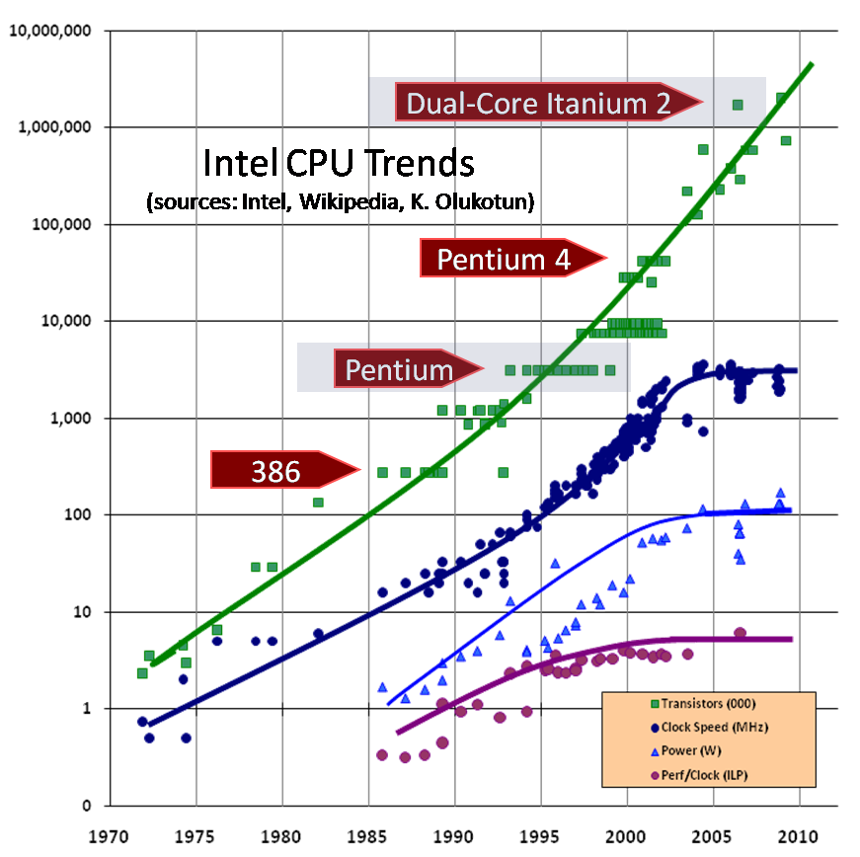

Slide 18
Power wall + ILP wall + memory wall = BRICK WALL
Power wall
we can’t clock processors faster
Memory wall
many workload’s performance is dominated by memory access times
Instruction-level Parallelism (ILP) wall
we can’t find extra work to keep functional units busy while waiting for memory accesses

Slide 19
Multi-core h/w – common L2
Core
Core
ALU
ALU
ALU
ALU
1
1
2
2
3
L1 cache
L1 cache
3
4
4
5
L2 cache
5
...
...
Main memory

Slide 20
Multi-core h/w – additional L3
Single-threaded core
Single-threaded core
1
1
2
2
3
L1 cache
L1 cache
3
4
4
5
L2 cache
L2 cache
5
...
...
L3 cache
Main memory

Slide 21
SMP multiprocessor
Single-threaded core
Single-threaded core
1
1
2
2
3
L1 cache
L1 cache
3
4
4
5
L2 cache
L2 cache
5
...
...
Main memory

Slide 22
NUMA multiprocessor
Single-threaded core
Single-threaded core
Single-threaded core
Single-threaded core
L1 cache
L1 cache
L1 cache
L1 cache
L2 cache
L2 cache
L2 cache
L2 cache
Memory & directory
Interconnect
Memory & directory
Single-threaded core
Single-threaded core
Single-threaded core
Single-threaded core
L1 cache
L1 cache
L1 cache
L1 cache
L2 cache
L2 cache
L2 cache
L2 cache
Memory & directory
Memory & directory
Notes:
Tim Harris

Slide 23
Three kinds of parallel hardware
Multi-threaded cores
Increase utilization of a core or memory b/w
Peak ops/cycle fixed
Multiple cores
Increase ops/cycle
Don’t necessarily scale caches and off-chip resources proportionately
Multi-processor machines
Increase ops/cycle
Often scale cache & memory capacities and b/w proportionately

Slide 24
Concept #2: Speedup

Slide 25
Speedup Concerns
Focus on the longest running parts of the program first
be realistic about possible speedups
different parts may need to be parallelised with different techniques
Understand the different resource requirements of a program
computation, communication, and locality
Consider how data accesses interact with the memory system:
will the computation done on additional cores pay for the data to be brought to them?
Notes:
From Tim Harris:
The performance of one thread is highly dependent on what other threads are doing
It’s important to understand the h/w of the machine, and the techniques it uses
For modest numbers of cores, it may be possible to identify large granularity tasks, with good data locality
Understand the different resource requirements of a program; computation, communication, locality
Consider how data accesses will interact with the memory system; will the computation done on additional cores pay for the data to be brought to them?
Focus on the longest running parts of the program first; be realistic about possible speedups
Aim to tackle larger workloads in constant time (c.f. Gustafson’s law)
Exploit asymmetric designs; larger cores for sequential perf, smaller cores where high degrees of parallelism are available
Multiple parts of an algorithm may need to be parallelised with different techniques
With modest numbers of cores, beware of overheads that must be recovered via parallelism

Slide 26
Abstractions for Speedup
Imperative parallelism
Parallel.For/ForEach
Lightweight tasks (not threads)
Functional parallelism
Functional programming (F#)
Parallel Language Integrated Queries (PLINQ)
Array parallel algorithms (Accelerator)
Concurrent components
for example, data structures that can efficiently accommodate many clients

Slide 27
Concept #3: Responsiveness

Slide 28
Responsiveness Concerns
Quick reaction to conditions over event streams
Handle multiple tasks at the same time
Don’t block essential tasks unnecessarily
Coordinate responses to requests

Slide 29
Abstractions for Responsiveness
Asynchronous computation
lightweight tasks (not threads)
F#’s async
Application-specific scheduling
Complex event handling
IObservable
Reactive extensions (RX) to .NET
Actors/agents

Slide 30
Concept #4: Correctness

Slide 31
Correctness Concerns
All those we have for sequential code
Assertions, invariants, contracts,
buffer overflows, null reference,
…
Plus those related to parallelism/concurrency
Data races, deadlocks, livelocks, …
Memory coherence/consistency

Slide 32
Correctness Abstractions
Atomicity
Determinism
Linearizability
Serializibility
Temporal logic

Slide 33
Outline
Context
Concepts
Units, Materials and Tools

Slide 34
Units 1 – 4
Unit 1: Imperative Data Parallelism
Data-intensive parallel programming (Parallel.For)
Concurrent Programming with Tasks
Unit 2: Shared Memory
Data Races and Locks
Parallel Patterns
Unit 3: Concurrent Components
Thread-Safety Concepts (Atomicity, Linearizability)
Modularity (Specification vs. Implementation)
Unit 4: Functional Data Parallelism
Parallel Queries with PLINQ
Functional Parallel Programming with F#

Slide 35
Units 5 – 8
Unit 5: Scheduling and Synchronization
From {tasks, DAGs} to {threads, processors}
Work-stealing
Unit 6: Interactive/Reactive Systems
External vs. internal concurrency
Event-based programming
Unit 7: Message Passing
Conventional MPI-style programming
Unit 8: Advanced Topics
Parallelization, Transactions, Revisions

Slide 36
Unit Dependences

Slide 37
IDE, Libraries, Tools, Samples, Book
Visual Studio 2010
C# and F# languages
.NET 4: Libraries for multi-core parallelism and concurrency
Other Libraries
Accelerator
Code Contracts
Rx: Reactive Extensions for .NET
Alpaca
A lovely parallelism and concurrency analyzer
Source code
Code for all units, with Alpaca tests
Parallel Extensions Samples
Free book: Parallel Programming with Microsoft .NET

Slide 38
Icon Guide
Performance
Concept
Correctness
Concept
Code
Concept
Alpaca
Project
Discuss
Run
Aside

Slide 39
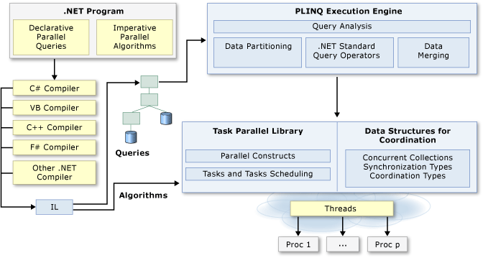
.NET 4 Libraries for Parallelism and Concurrency

Slide 40
Alpaca: A lovely parallelism and concurrency analyzer
Alpaca
Project
Atttribute-based testing, for performance and correctness concepts
[UnitTestMethod]
simply run this method normally, and report failed assertions or uncaught exceptions.
[DataRaceTestMethod]
Run a few schedules (using CHESS tool) and detect data races.
[ScheduleTestMethod]
Run all possible schedules of this method (with at most two preemptions) using the CHESS tool.
[PerformanceTestMethod]
Like UnitTestMethod, but collect & graphically display execution timeline (showing intervals of interest)

Slide 41
Why Alpaca?
Improve the learning experience for concurrent and parallel programming
Vehicle for including instantly runnable sample code (incl. bugs)
Unit tests: A quick way to validate / invalidate assumptions, about correctness or performance
Provide simple graphical front end for various tools

Slide 42
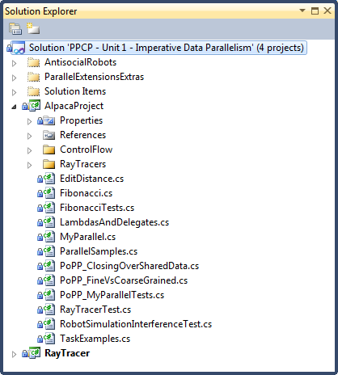
PPCP – Unit X - *.sln
Each Unit has a VS2010 Solution
supporting examples
Alpaca Project

Slide 43
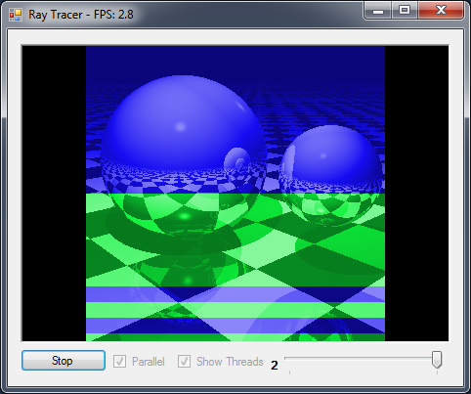
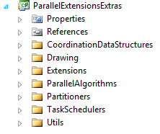
Parallel Extensions Samples
http://code.msdn.microsoft.com/ParExtSamples
Over 15 Samples
applications illustrating use of .NET 4
some included in courseware
ParallelExtensionsExtras.csproj
helper classes built on .NET 4
Run

Slide 44
Sample: Ray Tracer
Run
Animated, ray traced bouncing balls. Sequential and parallel implementations are provided, as is a special parallel implementation that colors the animated image based on which thread was used to calculate which regions.

Slide 45
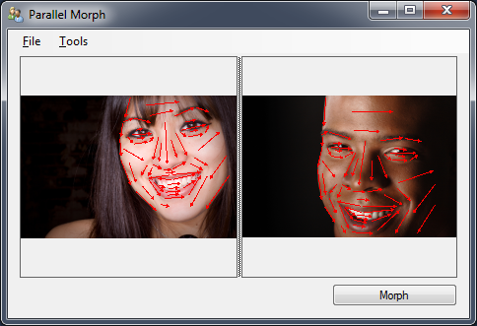
Sample: Image Morphing
Run
Implements a morphing algorithm between two images. Parallelization is done using the Parallel class.
Notes:
Not included in courseware, get as separate download

Slide 46
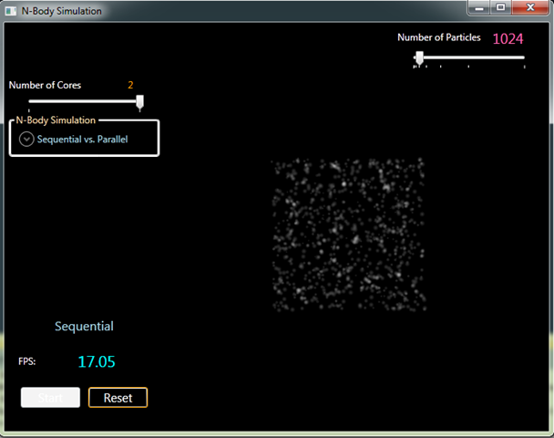
Sample: N-Body Simulation
Run
Implements a classic n-body simulation using C# and WPF for the UI and using F# for the core computation. Parallelism is achieved using the Parallel class.

Slide 47
Free book: Parallel Programming with Microsoft .NET
Design Patterns for Decomposition and Coordination on Multicore Architectures
Colin Campbell, Ralph Johnson, Ade Miller and Stephen Toub

