Slide 1
Preliminaries II
CS5540 Human Computer Interfaces
Rich Riesenfeld
Fall 2010
Lecture Set 2

Slide 2
Donald A. Norman, Psychology/Design of Everyday Things
Lecture Set 2

Slide 3
Affordances
Affordances refers to the perceived and actual properties, esp wrt how it is used or applied
Affordances provide “strong clues” to the operation of things

Slide 4
Mappings
Mappings refers to the relationship between two things
Eg, control and movement
Steering wheel
Door handle

Slide 5
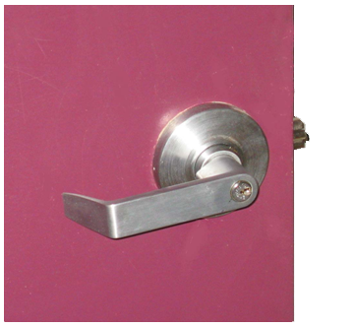
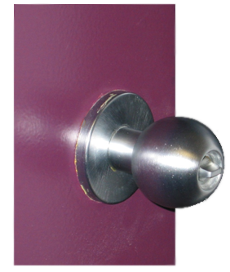
Map’s & Afford’s: Ex’s - 1
Door Knobs v Levers

Slide 6
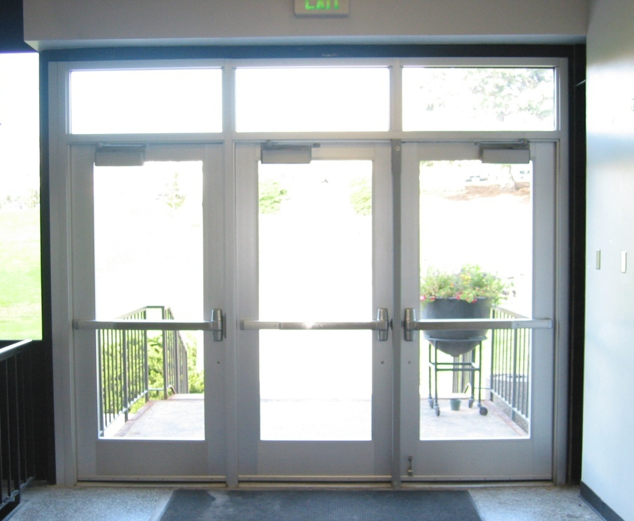
Map’s & Afford’s: Ex’s - 2
Doors open left or right ?

Slide 7
Map’s & Afford’s: Ex’s - 3
Lego pieces

Slide 8
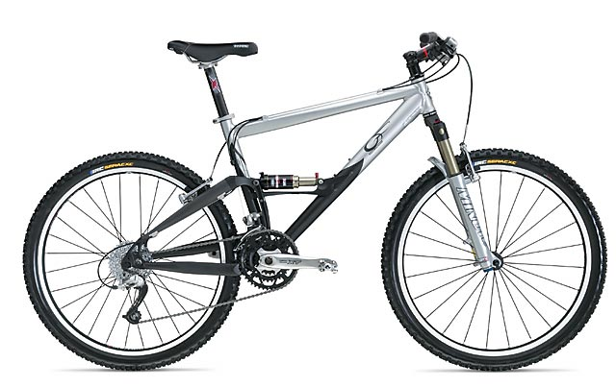
Map’s & Afford’s: Ex’s - 4
Bicycle
Seat, position, handlebars, brakes

Slide 9
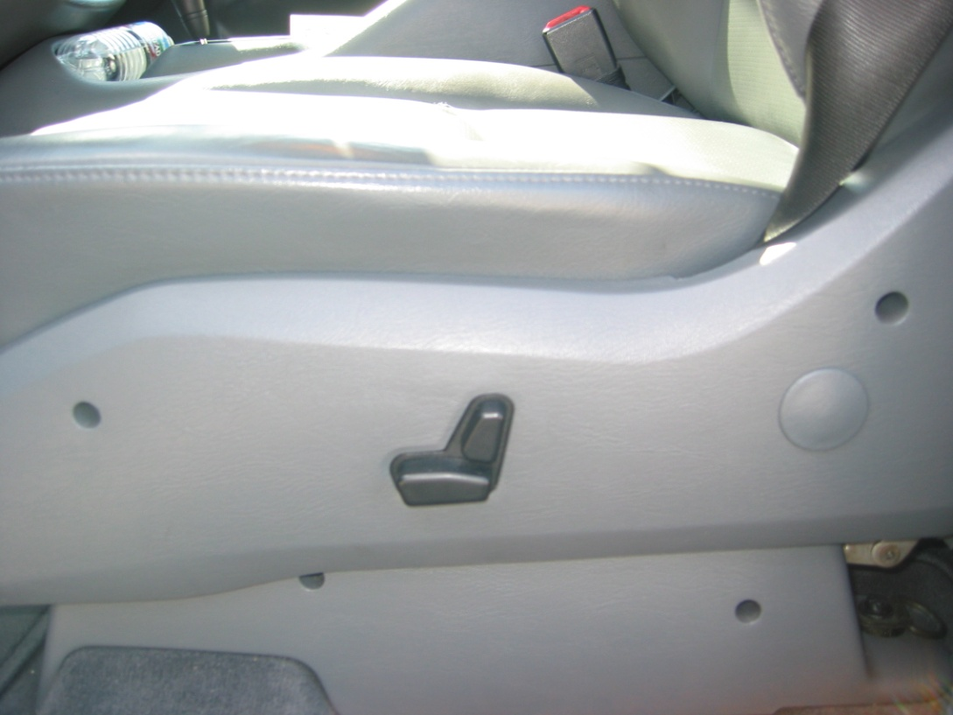
Map’s & Afford’s: Ex’s - 5
Mercedes power seat adjustment

Slide 10
Map’s & Afford’s: Ex’s - 6
Motorcycle
Clutch, shifting pattern
Climate Control in (most) cars-
Want to set temperature
Really setting amount of hot water circulating through radiator

Slide 11
Mappings & Affordances: Ex’s -2
Sound System Controls
Knobs v Sliders
TV Controls
Menus
Triggers
Joystick controls

Slide 12
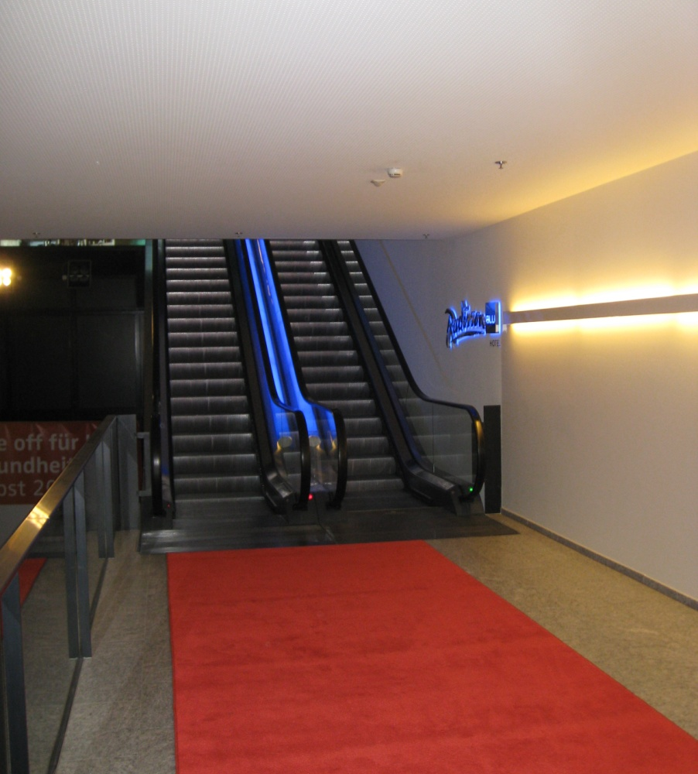
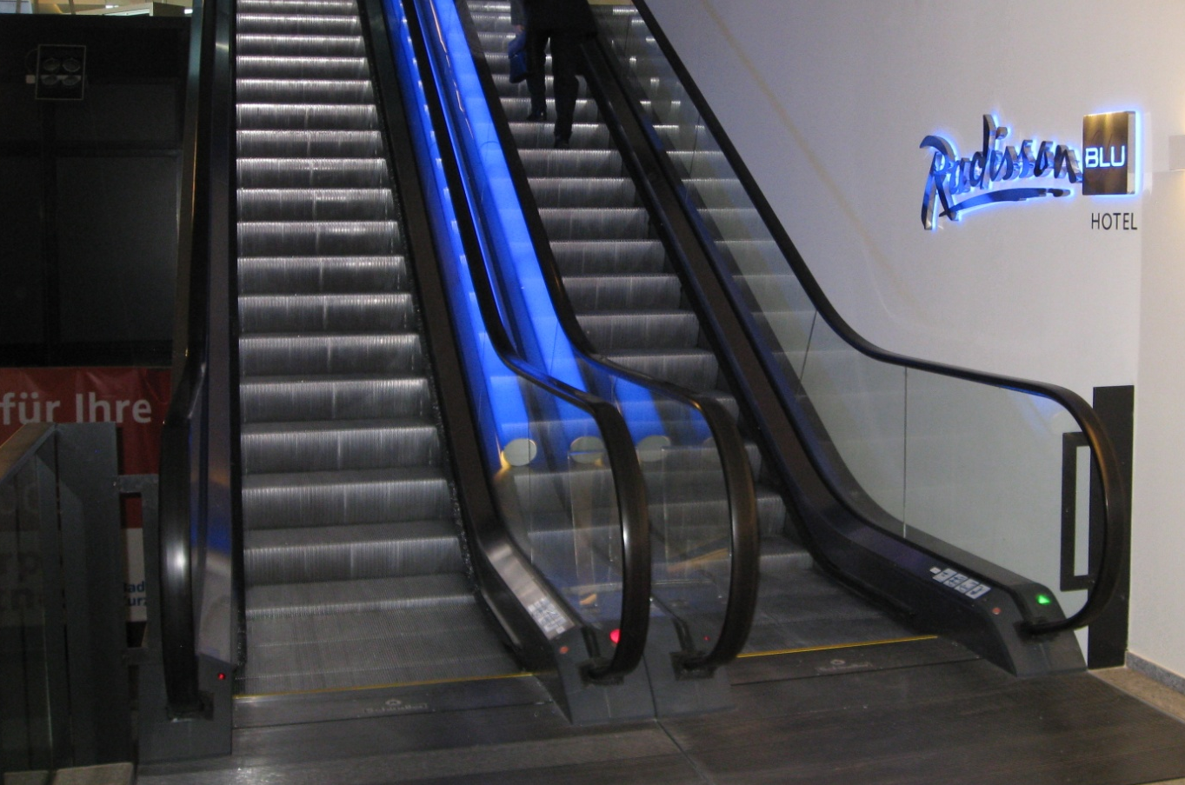
Is this function obvious?

Slide 13
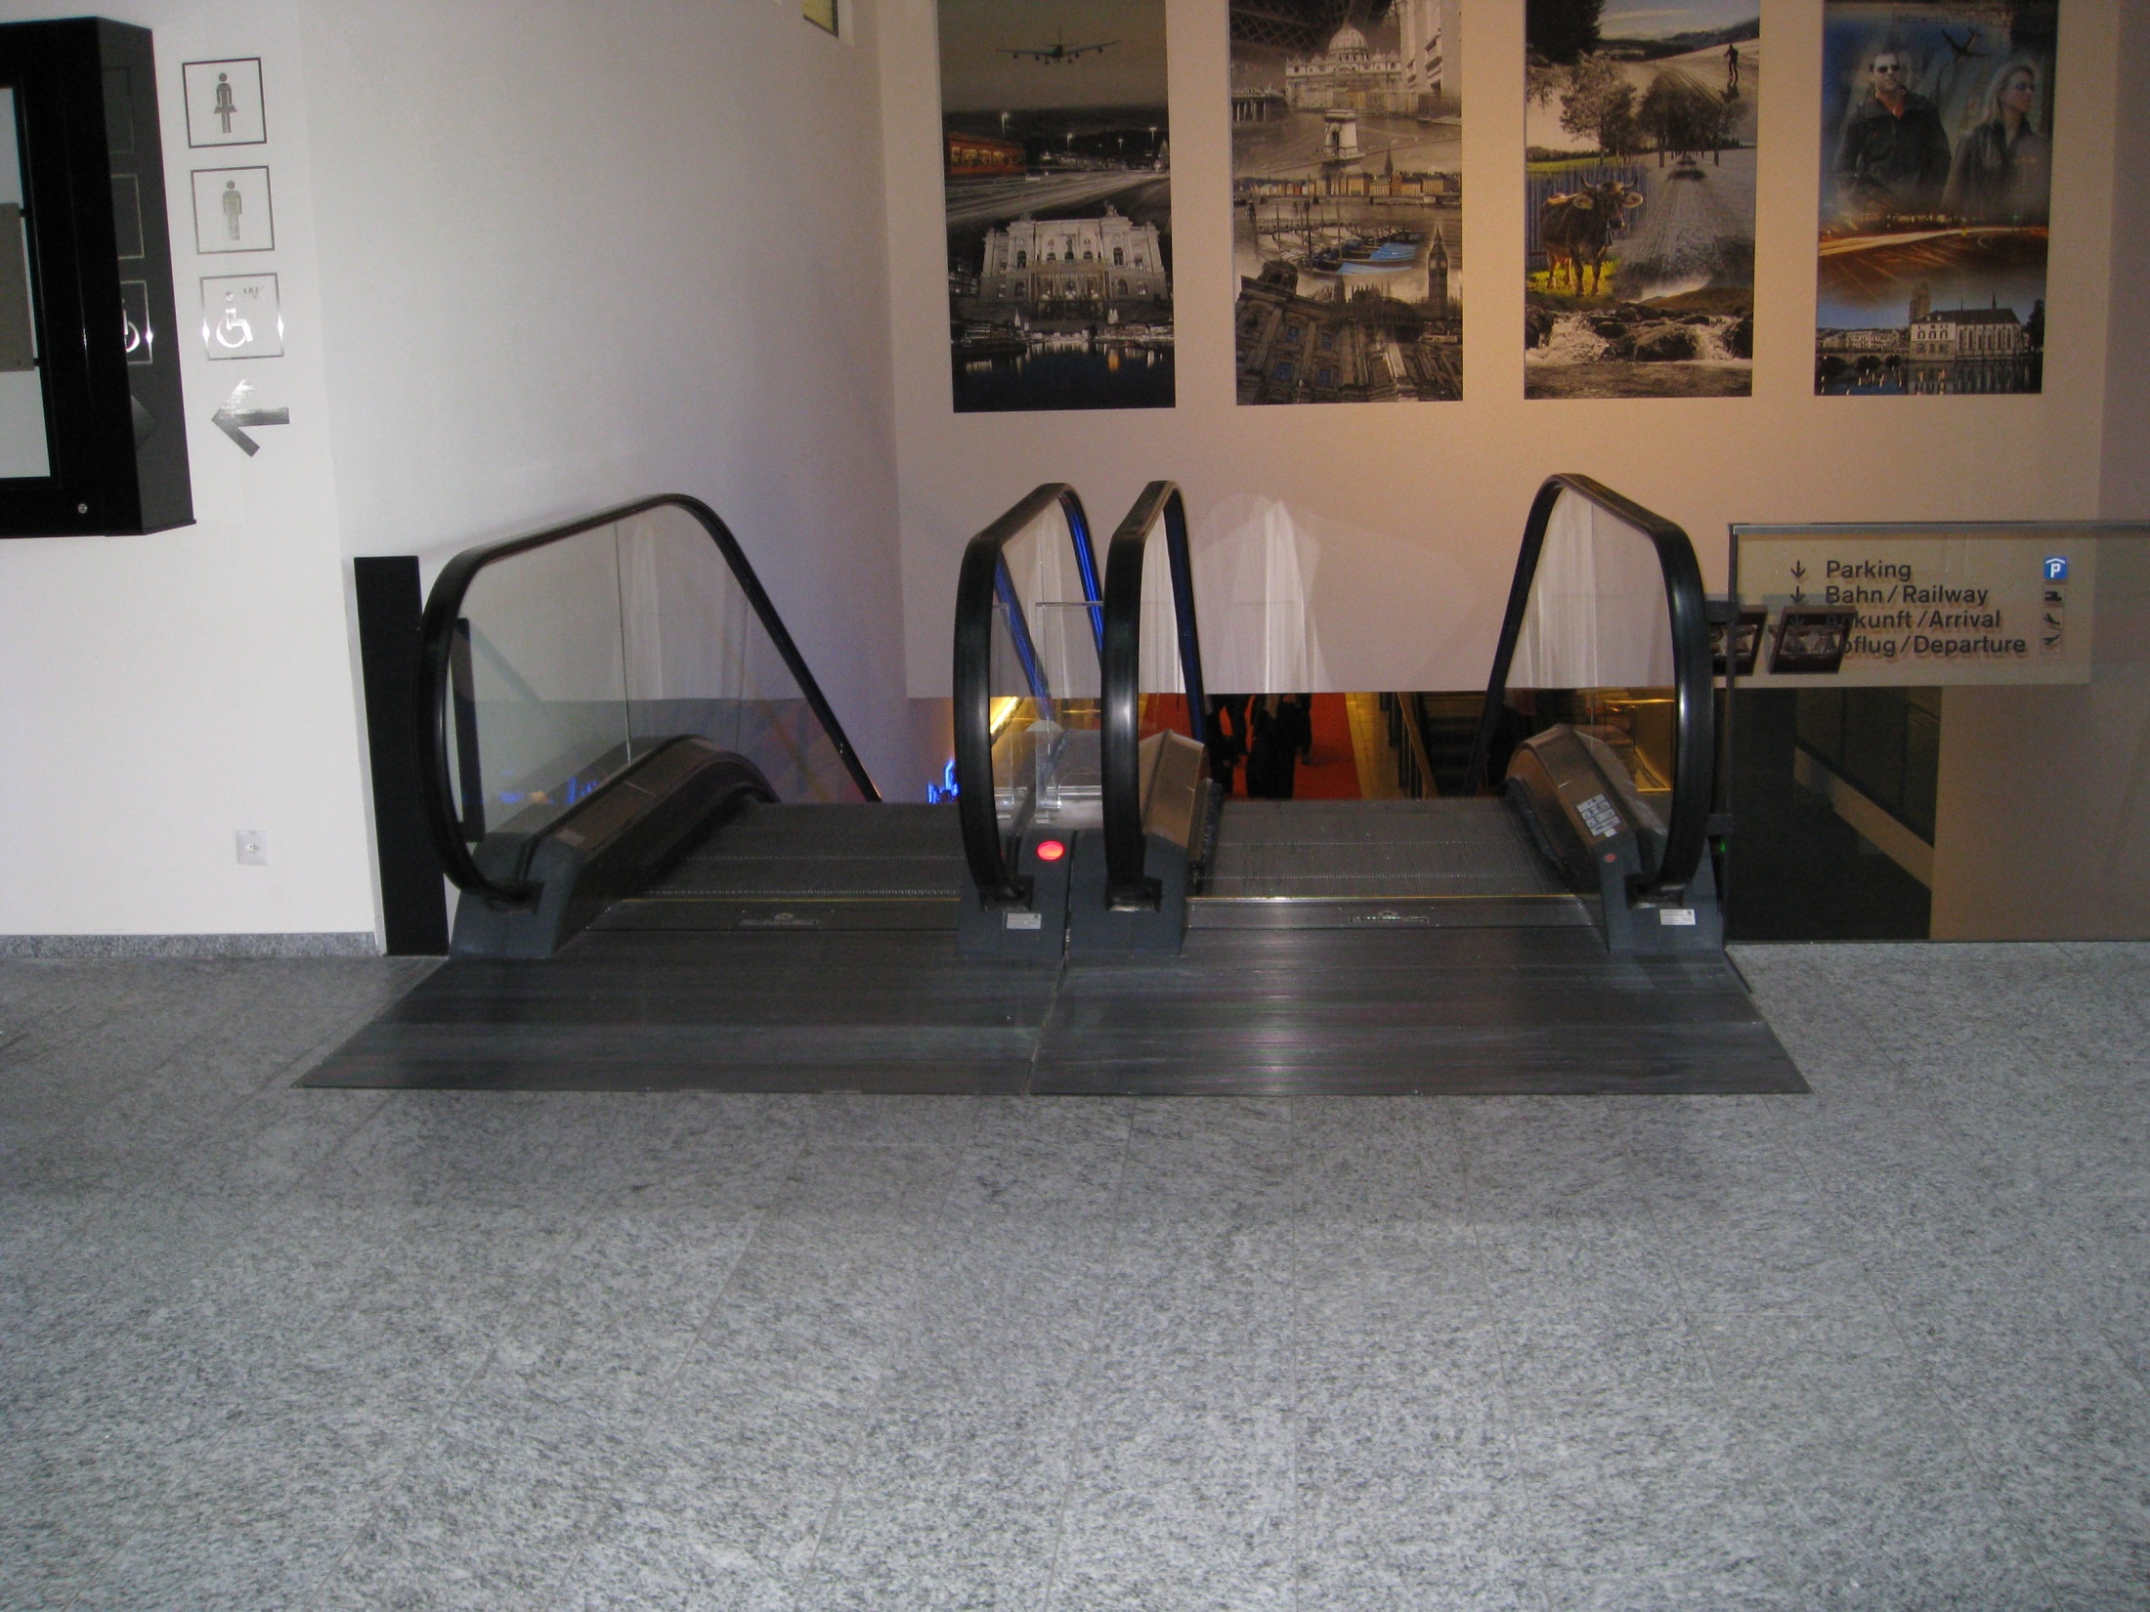
Is this function obvious?

Slide 14
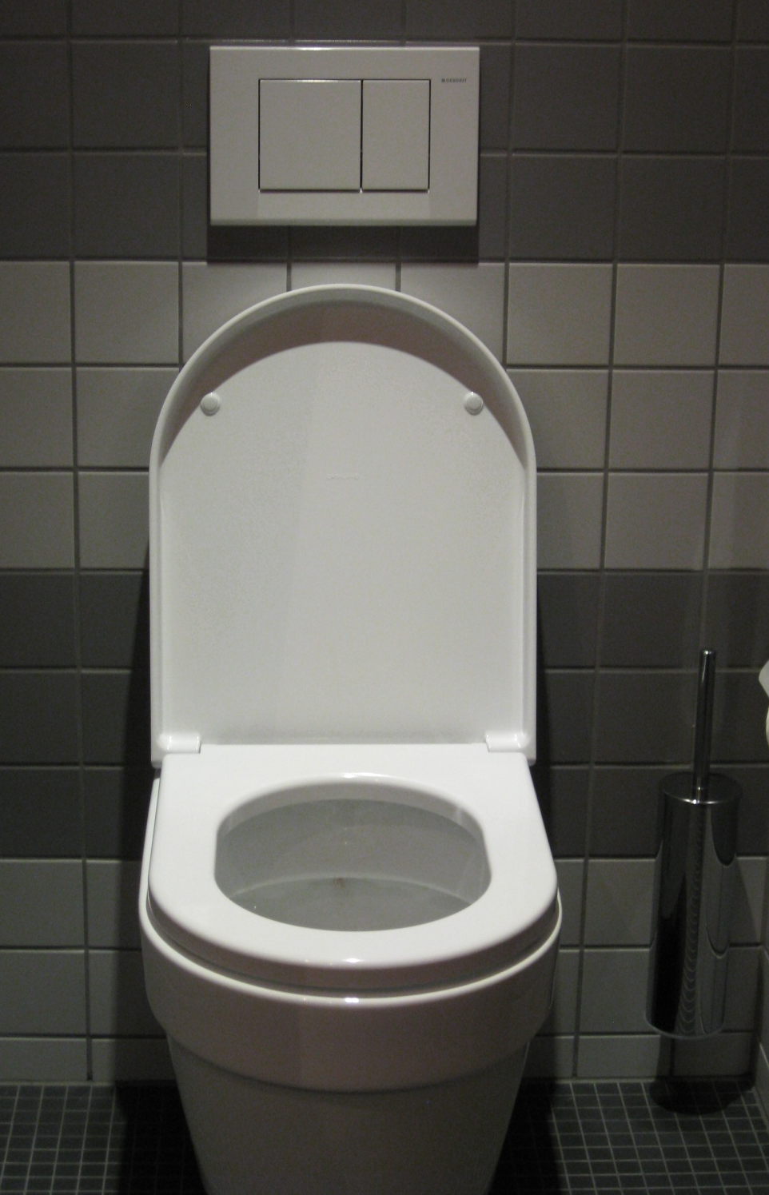
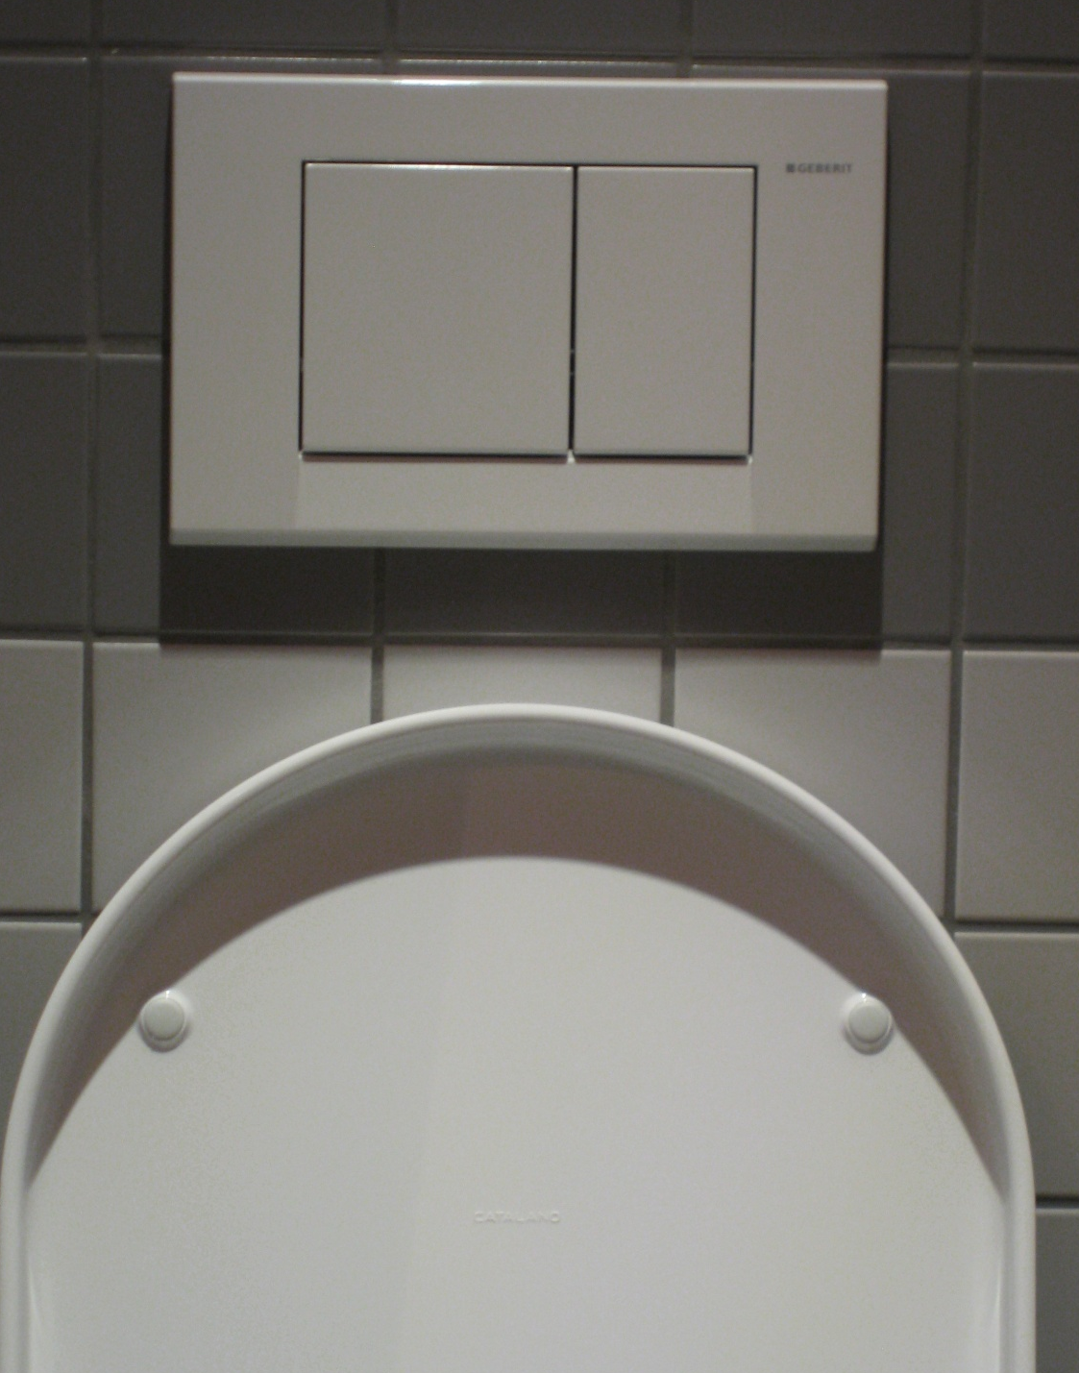
Is this function obvious?

Slide 15
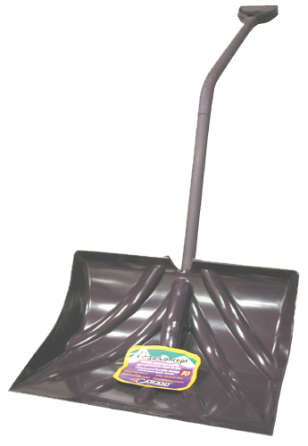
Functionality v Interface/Mapping

Slide 16
Huh? What’s this ?
Want to see the
Wovel at work ?

Slide 17
Widgets

Slide 18
7 Stages of Action - 1
Form Goal
Form Intent
Specify Action
Execute Action
Perceive State of World
Evaluate Outcome
Interpret State of World

Slide 19
7 Stages of Action - 1
Abstraction
Form Goal
Execution Phase
Form Intent
Specify Action
Execute Action
Evaluation Phase
Perceive State of World
Evaluate Outcome
Interpret State of World

Slide 20
7 Stages of Action - 2
Form Goal
Get more light to read

Slide 21
7 Stages of Action - 2
Form Intent
Flip on a wall switch
Specify Action (Instantiate Plan)
Get out of chair, walk to switch …
Execute Action
Carry out plan

Slide 22
7 Stages of Action - 4
Perceive State of World
Collect external data
Evaluate Outcome
Interpret State of World

Slide 23
Issues
Gulf of Execution
Wrong thing happened
Unexpected response
Gulf of Evaluation
What is going on?
What am I?

Slide 24
Control Structures
Shallow structures
ice cream store menu
Narrow structures
Cooking recipe
small vocab
many steps

Slide 25
Expect Bad Input
Design for errors
Making mistakes is normal
Implement fault tolerant designs
redundancy

Slide 26
Designing for Errors - 1
Understand the cause, and minimize
Implement UNDO
Make errors easy to
detect
Correct
Think of user as
engaged in approximate behavior
don’t think of it as wrong behavior

Slide 27
Designing for Errors - 2
Example: Locking keys in car
various alerts and inhibitions
don’t want a voice telling you that you just locked your keys in car!

Slide 28
Forcing Functions - 1
Forcing Functions are a form of physical constraint
Make this hard to turn, hard to open
Barriers
Loud fire alarms (120 db !)
Inadequate password rejection

Slide 29
Forcing Functions: Examples - 2
Child-proof medicine containers
Engaging reverse in a car
Inhibit start w transmission
Critical military decisions
Requires two authorized people
Fire extinguisher

Slide 30
Forcing Functions - 3
Recessed reset button on equipment
Turnstiles and automatic gates
Speed governors on fleet cars
Function car locks
Child locks on rear doors
Automatic locking when in Drive
Locked steering wheel w/o key

Slide 31
Forcing Functions - 4
Automatic seatbelts restraints
Open microwave door inhibits POWER
Self-cleaning oven – door stays locked
Firearm safety settings
Double instead of single mouse click
Elevator – door must be closed

Slide 32
Forcing Functions - 5
Legal and psychological
Policeman at intersection
Police car at roadside
Security
Security guard
Surveillance camera
Surveillance sign (not for sale, officially)
Guard dog – or any dog

Slide 33
Forcing Functions: Advisories - 6
“Shoplifters will be prosecuted to the fullest extend of law”
“Speed enforced by radar”
Radio alert provided by police
Radar in operation in following areas
Reminder of consequences
Punishable by fine, jail, suspension, removal, etc.

Slide 34
Forcing Function Approach- 7
Drastic, imposing, assertive, militant, authoritative, officious, Big Brother, risky
When to use?
This is a choice of the stick over carrot
Often has a goodwill cost
Motorcycle helmets
Seatbelts
Child restraining seats

Slide 35
Forcing Function Approach- 8
What circumstances justify this approach?
Safety?
Potential for major damage?
Harm to others/society?

Slide 36
Forcing Function Approach- 8
When does the user subscribe to the approach; when is it resented?
Gun control
Restricted (superuser) functions
Speed limits on German autobahn
Dress/behavior codes

Slide 37
Forcing Function Approach- 8
When does the user subscribe to the approach; when is it resented?
Drug control
Need a prescription
Only dispensed for 1 month supply; cannot renew
Cannot call-in to pharmacy
ID required
Not honored from out-of-state prescription

Slide 38
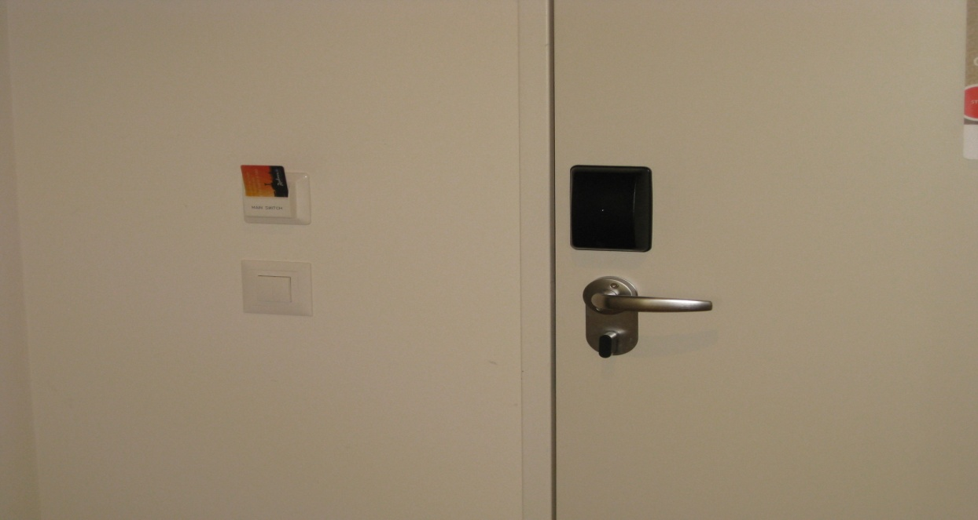
Forcing Function Approach- 8

Slide 39
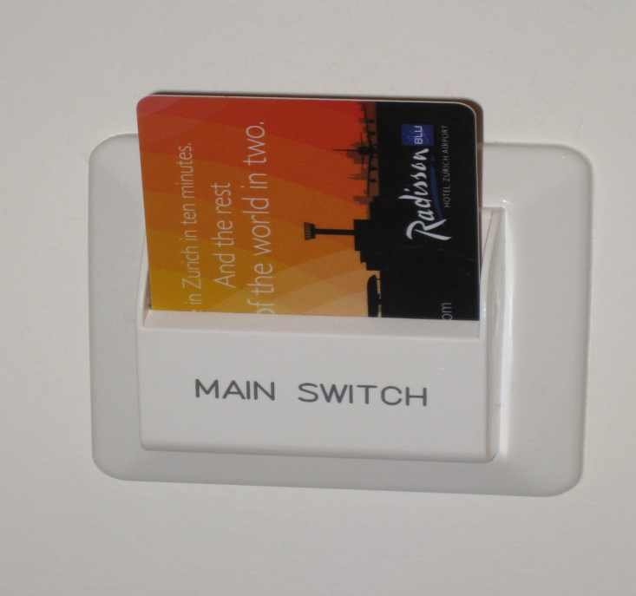
Forcing Function Approach - 8

Slide 40
Fault “Intolerance”
Design so that only correct actions can be taken
Nuclear power plants
Cockpits: Flaps down
Shifting into reverse
Assemble only one way: right way!

Slide 41
Visibility
Allow the user to be informed
Show him the state
Where is the elevator?
Can I see the elevator in its shaft?
Is the tape in correctly? Is it engaged?

Slide 42
Interpreting Data
Swiss Air flight
low oil pressure, level on Eng 1
turn off Eng 1
ditto on Eng 2 & 3
impossible, not reasonable!

Slide 43
Interpreting Data
This happened!
New procedure
Same mistake on all engines
Oil ran out because of maintenance error on new procedure
World view was wrong

Slide 44
Effecting Actions
Command mode
3rd Person
Proxy
“fly by wire”
Direct control
“hands on experience”
good haptic feedback

Slide 45
Make Complicated Simpler - 1
Use both world and user knowledge
Can lead to difficult choices
Simplify structure of tasks
Make things visible
Bridging execution and evaluation

Slide 46
Make Complicated Simpler - 2
Get mappings right
test and validate
Exploit constraints
Design for error
Standardize
Weight cost/benefit of choices

Slide 47
End D A Norman Notes
End Lec Set 2

