Slide 1
Official Interface Guidelines
User interface documentation published by Apple and Microsoft

Slide 2
Basic Principles (everybody agrees on these)
See-and-point
Metaphors
Files and folders
Direct manipulation
User control
Actions initiated by the user, not the computer
Modelessness
Interactive and responsive

Slide 3
Basic Principles
Feedback and communication
Consistency
Internal and external
Consistent with the guidelines
WYSIWYG
Forgiveness
Perceived stability
Aesthetic integrity
Good visual design
Simplicity
Simple, not simplistic

Slide 4
Basic Principles
Good first experience
Clear and simple installer
Convenient default settings
Follow the platform’s own guidelines
Ignoring them reduces their usefulness for all other applications

Slide 5
Platform-Specific Details
Appearance, layout and usage of interface elements
Keyboard shortcuts and other actions
Navigation
Modifier keys (shift, control, etc.)
Mouse cursors and meanings of buttons
File organization on disk

Slide 6
Dealing With Differences
Pet peeve: porting an application without adapting to the new platform’s standards
What do these keys do when editing text:
Home
End
Page up/down
Notes:
Microsoft and Macromedia ported their Windows apps to the Mac OS without adopting Mac text navigation standards
PC: Home moves insertion point to beginning of line, End moves to end
Mac: Home scrolls to top of document, End scrolls to end
Page up/down don’t move the insertion point on the Mac

Slide 7
Beyond the Guidelines
There are cases when you have to create new interface elements
Make sure they appear integrated
Give them an appearance consistent with everything else
Make the different behavior obvious
Don’t just use a standard element and make it do something else
Notes:
If it looks like a regular push button, it should act like one
If you’ve modified it to produce a popup menu or something, add an indicator

Slide 8
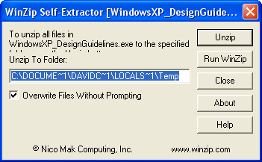
Microsoft’s Guidelines
This is what you get when you download Microsoft’s guidelines for Windows XP
Notes:
How many mistakes can you find in this picture?
Text is cut off
DOS path name - is it that hard to use a standard save dialog?
No browse button - you have to figure out the DOS path name for the folder you want
Close button should be Cancel
Buttons should be more separated, since they perform a wide variety of functions

Slide 9
Push Buttons
You click it, and something happens
Choose the title text carefully
Apple:
“Button names should be verbs that describe the action performed”
Microsoft:
“Aim for the shortest possible label; one word is best.”
“If possible, use label text that makes sense when read out of context — for example, when a user reads or hears only the label of the current control.”
Notes:
An example of guidelines for a particular element
On both platforms, “Yes” and “No” are not good choices for button titles
Microsoft doesn’t always follow this - Excel’s dialog to confirm deleting a sheet includes an explanation of what each button will do, instead of using specific text for the button titles (Mac version at least)

Slide 10
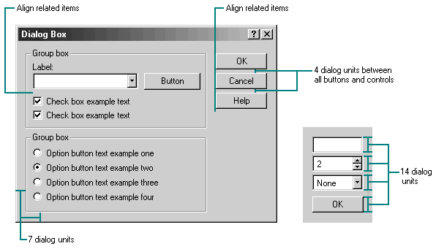
Layout

Slide 11
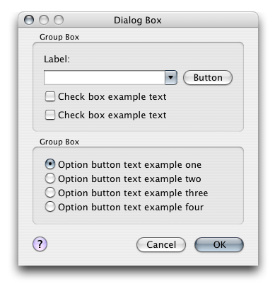
Layout
Notes:
Apple has a program called Interface Builder which automatically helps you use the correct spacing
Notice the differences between this window and the Windows version?
Buttons are moved to the bottom
Special Help button, not just a push button that says “help”

Slide 12
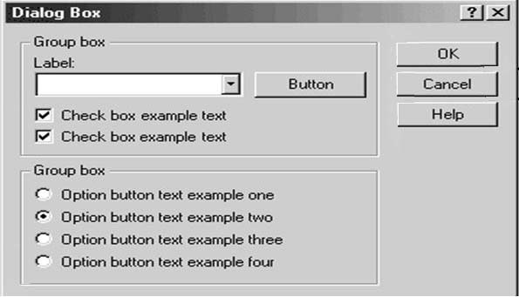
Layout

Slide 13
Icons
Icons get used for lots of different things
Representing objects
Files
Tools
Representing commands
Open
Undo
..often shortcuts to menu commands that have no icon

Slide 14
Icons
There are guidelines for these too
Apple:
Design and composition should indicate purpose
Perspective should agree with real-life interactions
Differentiate them from other UI elements
Microsoft:
Colors that complement the XP design
Perspective is either at a certain angle, or straight-on
Everyday objects should look modern
Notes:
Microsoft seems more interested in having 3rd part icons that fit the XP style
Apple is more concerned with composition than having everyone imitate their “photo-illustrative” style

Slide 15
Microsoft Icon Composition
Exceptions:
Document icons
Symbols such as warning
Single objects
Objects not recognizable at an angle
Notes:
Icons are either in that particular perspective, or straight-on

Slide 16
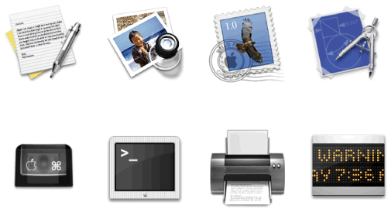
Apple Icon Composition
Icon “genres”
Application: media (paper) and tool (pen)
Utility: straight perspective, subdued colors
..also document, plug-in, toolbar
Notes:
The perspective (and shadow) of an icon should agree with how you interact with its real-life counterpart: on a desk, on a shelf, in your hand

Slide 17
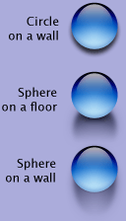
Pet Peeve: Shadows
Shadows help add dimension to the image
The shadow can do as much as the object itself in defining its shape
Careless use can flatten the object
Notes:
The ball is exactly the same in all three cases; the shadow defines its shape (flat or spherical) and its relationship to its environment (on a wall or floor)

Slide 18
Summary
Concrete examples of the principles we’ve been discussing
There are professionals who actually believe in what we’ve been discussing
You don’t have to design every single element of your application
..in fact you shouldn’t
..most of the time

Slide 19
Sources
Apple’s User Experience page
http://developer.apple.com/ue
Microsoft’s User Interface Design and Development page
http://msdn.microsoft.com/library/default.asp?url=/nhp/default.asp?contentid=28000443
Notes:
Kirstie brought up a good point: how easy are the guidelines to navigate/use?
Apple does a better job of collecting it all in one document; Microsoft’s are a bit scattered

