Slide 1
Preliminaries
CS5540 HCI
Rich Riesenfeld
Fall 2008

Slide 2
What is the HCI Issue?
Is the interface the concern?
Is the issue a matter of accomplishing work, some set of tasks?
Are we focusing on wrong thing?
We don’t discuss telephone interfaces often.

Slide 3
“Doing Work” View - 2
Need to understand the user and human behavior
How does an architect approach a custom home design for a new client?

Slide 4
What good interface principles |  | - 1
 | do we already know?
Interesting, pleasing, attractive, inviting
Effective to use
Intuitive: Alan Kay’s children
Organized, hierarchically structured, clean

Slide 5
What good interface principles |  | - 2
 | do we already know?
Help functions, Search, etc
Consistent form (aka design integrity)
Automatic assistance
Completions
Spelling

Slide 6
What good interface principles |  | - 3
 | do we already know?
Lead the user
Prompts
Indicate nature of any problem
Specific communication
Navigational aids: systems often huge

Slide 7
What good interface principles |  | - 4
 | do we already know?
Meaningful error msgs
Don’t send you elsewhere
Give useful data
Area of inadequate traditions
Multiple paths to a function
Keep it simple

Slide 8
What good interface principles |  | - 5
 | do we already know?
Gain user’s trust
Bottom up is probably most acceptable
Simple tasks should be simple
WYSIWYG – easy to get started
Piano v violin
Notes:
We ended class on Bullet 2

Slide 9
Our history hurts us…- 1
Developed some poor communications habits
Natural language is terribly ambiguous
Resources were scare
Other priorities, historically

Slide 10
Our history hurts us… - 2
Error Messages
Early computing: “Compiler error”
Even now: Sys Error EM732851
Error from wrong module: Latex
Small road signs
Confusing directions
400 S HOV Interchange on I15

Slide 11
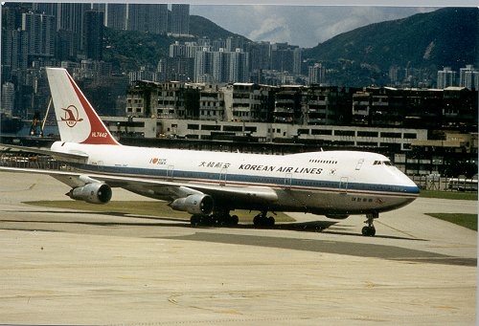
Our history hurts us: KE007 - 3
KE007
1 Sep 1983

Slide 12
Our history hurts us… KE007 - 4
Korean Airlines Flight 007
269 onboard, veered over Soviet airspace in Pacific, and was shot down
Pilot/Navigator keyed in numerical coordinates by hand for flight plan!

Slide 13
Our history hurts us… KE007 - 5
How about:
Automatic download?
Picking from a menu?
Symbolic names?
Confirmation playback?

Slide 14
Our history hurts us… KE007 - 6
How about:
Context check (like type-checking…)?
Pilot, run, time, plane, schedules, assignments, etc

Slide 15
Our history hurts us… KE007 - 7
How about:
Monitors, Alarms, Inhibitors?
Confirmation message?
Aviation tower communications
Telephone technical conversations
Parity checks?

Slide 16
Our history hurts us… - 8
Audi
Cars took off from a standing position
Driver error, claimed Audi…
Whose error was it?

Slide 17
Our history hurts us… - 9
NASA’s Mars Orbiter space probe
NASA’s Polar Lander Mars space probe

Slide 18
Our history hurts us… - 10
NASA space probe
Lost major mission over units mistake
JPL group worked in SI units
Colorado group worked in English units
Combining the results let to bad numbers
Type checking issues?

Slide 19
Culture -1
What does this sign mean?

Slide 20
Culture -2
What does this sign mean?

Slide 21
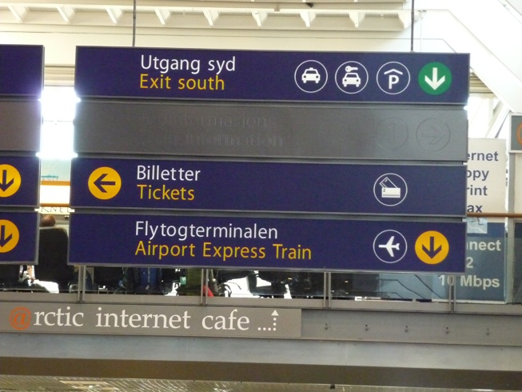
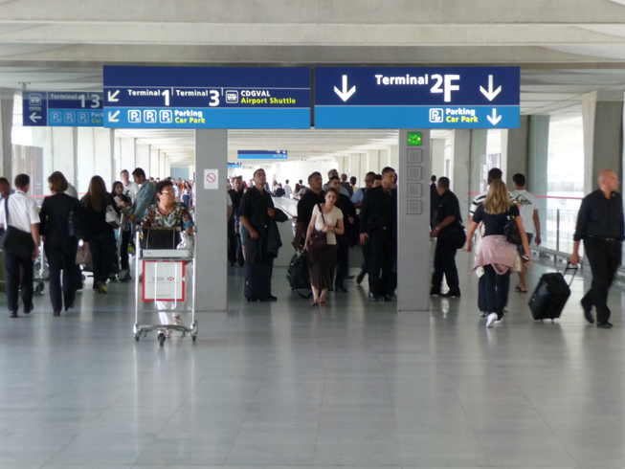
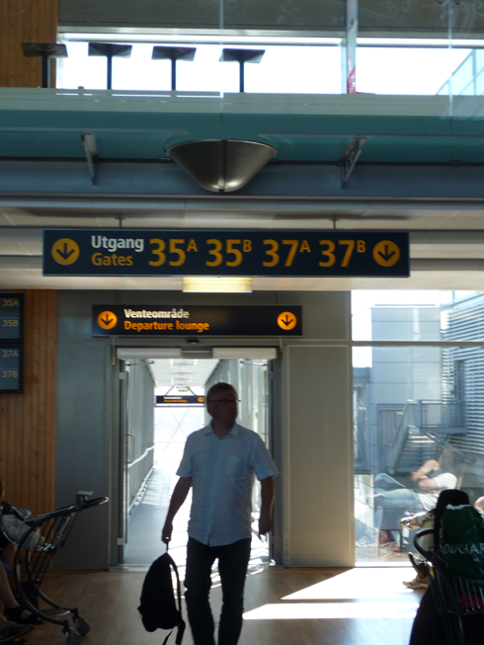
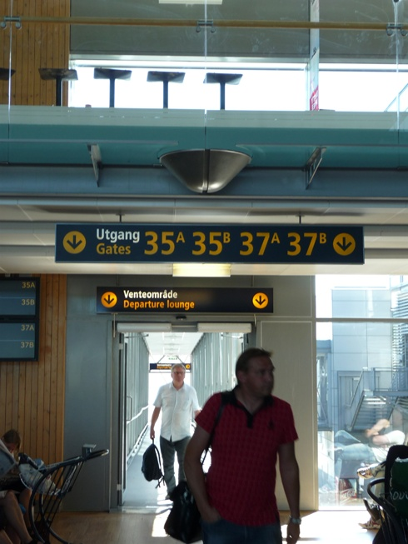
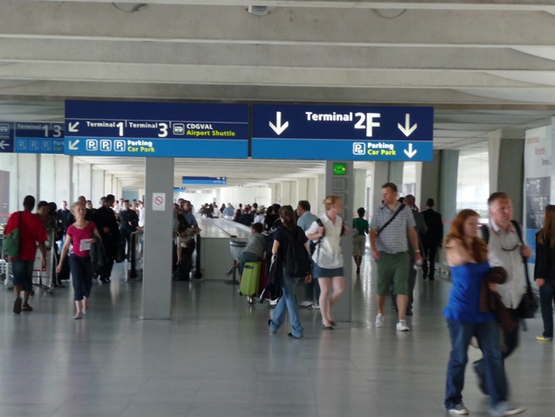

Slide 23
Culture -3
Up is better than down
Religion, Dante, …
When we refer to ourselves
We point to our noses?
Our chests?
Point with index finger or hand ?

Slide 24
Critical Interfaces
Nuclear power plants: 1961 SL1 nuclear disaster
Interface had better be clear and foolproof
Airplane cockpit
Computer graphics has simplified controls, infomation
Power saw, laser indicator

Slide 25
Accessibility of Controls
Where is the interface?
Where is the emergency “Off” ?
Access causes:
Exposure to danger
Confusion
Loss of critical time
Distraction (John Denver’s plane crash)
Disorientation

Slide 26
Parameter Overload
Too many choices
What does a parameter (widget) do?
Which is the most important at this time?
Examples

Slide 27
Effect of Function: Examples
Water faucets in a sink
Manual gear shift: 4 on the floor
Chords on a guitar: hard!
Interface is dictated (confused) by needed function

Slide 28
Other Historical Examples
Books are essentially linear
Stories or communications needs are not
Hyper-text
Breaks the shackles of linear text stream
Digress as needed, desired

Slide 29
HCI is a Design Problem
Design is old subject
Well studied, rich traditions
Apply design methodologies to build better interfaces
We will look at this viewpoint

Slide 30
Important Operational Issues
Reliability
Availability
Security
Data integrity

Slide 31
Important Basics
Standardization across app’s
Apple did this first
Integration of packages and tools
Unix does this well
Consistency in actions, design style, terms, menus, color, fonts, etc
Portability across platforms
Less than advertised (Quicken, eg)

Slide 32
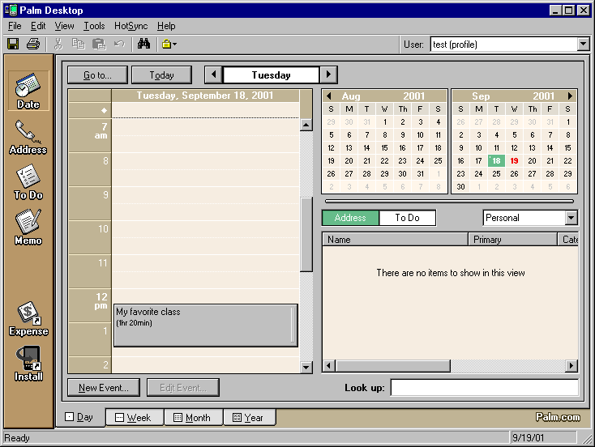
Palm Desktop Calendar

Slide 33
Palm Handheld Calendar

Slide 34
Important Stats -1
Time to learn
Speed of performance
How much coffee can one drink?
Rate of errors by users
“The user is always right!”

Slide 35
Important Stats -2
Retention over time
Do you have to start at square 1?
Subjective satisfaction
Do you like it (no explanation needed!)
Can you develop attachment for it?

Slide 36
Dramatically Different Needs - 1
Life-critical systems
Air traffic; nuclear reactors; cockpits; power utilities; emergency, military, medical, operations
Commercial
Banks, resv’s, inventory, point-of-sales (Hertz, Fedex,..), registration,..

Slide 37
Dramatically Different Needs - 2
Home, office, entertainment
Obvious needs
Exploratory, creative, cooperative systems
Bad interface (computer or otherwise) can destroy the process

Slide 38
Human Diversity
Ergonomics, anthropometry
Anyone here “average?”
Physical consideration
Height, stiffness, posture, shapeness, size of working area
IPD, headsize, light sensitivity
Lefthandedness

Slide 39
Cognitive Processes |  | - 1
 | (from Engineering Abstracts)
Short-term memory
Long-term memory
(Over 40 year old users…)
Problem solving
Decision making
Armageddon situations

Slide 40
Cognitive Processes |  | - 2
 | (from Engineering Abstracts)
Attention and set (scope of concern)
ADHD, Ritalin population (5%)…
Search and scanning
Time perception

Slide 41
Perceptual and Motor |  | - 1
 | Performance Factors (ibid)
Arousal and vigilance
Fatigue
Perceptual (mental) load
Knowledge of results
Monotony and boredom

Slide 42
Perceptual and Motor |  | - 2
 | Performance Factors (ibid)
Sensory deprivation
Sleep deprivation
New driving regulations
Medical interns/residents
Anxiety and fear
Isolation

Slide 43
Perceptual and Motor |  | - 3
 | Performance Factors (ibid)
Aging
Drugs and alcohol
Circadian rhythms

Slide 44
Gender Differences
Males and Females are different!
Aggressive comparisons
Learning environments
Positive v. Negative Reinforcement
Sensitivities
Much has been observed
Firm principles are scarce
Some research at Stanford

Slide 45
Carl Jung’s |  | - 1
 | Personality Differences
Extrovert v Introvert
Extroverts like action
Sensing v Intuition
Routine v discovering new

Slide 46
Carl Jung’s |  | - 2
 | Personality Differences
Perceptive v judging
New situations v planning
Feeling v thinking
Sensitive v logical

Slide 47
Recent Study Result …
Multi-tasking does not work!
Ergo, one should not:
Drive a car
Talk on a mobile phone
Q: Is driving a car a single task??

Slide 48
Cultural & International Diversity - 1
Characters, numerals, special characters, diacriticals
Left-to-right v (right-to-left or vertical reading)
Date and time formats
International standards
Numeric and currency formats

Slide 49
Cultural & International Diversity - 2
Weights and measures
Telephones and addresses
Fixed v variable length
Names and titles
Mr., Ms., Mme, M., Dr.
SSNs, national IDs,
Capitalization and punctuation

Slide 50
Cultural & International Diversity - 3
Sorting sequences
Different alphabets
Icons, buttons, colors
Pluralization, grammar, spelling
Etiquette, policies, tone, formality, metaphors

Slide 51
Users with Disabilities
Can truly open doors
Man with ALS who uses head to type
Doing it well requires good client model
Designer challenges

Slide 52
Evaluating Interfaces - 1
Understanding of a practical problem
Lucid statement of a testable hypothesis
Manipulation of small number of independent variables
Measurement of specific dependent variables

Slide 53
Evaluating Interfaces - 2
Careful selection and assignment of subjects
Control for bias in subjects, procedures, and materials
Application of statistical tests
Interpretation of results, refinement of theory, and guidance for experimenters

Slide 54
Possible Research Directions - 1
Reduced anxiety of computers
Graceful evolution of systems
Specification and implementation of interaction
Direct manipulation

Slide 55
Possible Research Directions - 2
Input devices
Online assistance
Information exploration
Applications across platforms

Slide 56
End of Lecture Set 1 Preliminaries

