Slide 1
Preliminaries I
CS5540 HCI
Rich Riesenfeld
Fall 2009
Lecture Set 1

Slide 2
What is the HCI Issue?
Is the interface the concern?
Is the issue a matter of accomplishing work, some set of tasks?
Are we focusing on wrong thing?
Do we often discuss telephone interfaces?

Slide 3
What is the HCI Issue?
Is the interface the concern?
Is the issue a matter of accomplishing work, sbome set of tasks?
Are we focusing on wrong thing?
Do we often discuss telephone interfaces?

Slide 4
Is Interface Point of Disc ? - 2
Do we often discuss telephone interfaces?
Does dancer look at his/her feet?
Does guitar player look at string?
Does driver look at pedals?
Does …?

Slide 5
“Doing Work” View
Need to understand the user and human behavior
How does an architect approach a custom home design for a new client?

Slide 6
Ex: Architecture’s Bubble Diagram ͋
- 1
Tool architects use in initial design phase
Assists in capturing living dynamics & flow
Helps to drive suitable layout
_____________
͋ Succeeding Bubble Diagram section based on Flickr post . . , (Aug 2009) by Harrison Architects
Notes:
Diagrams way of diagramming the basic relationships and connections between the rooms or functions of a building. Heavier lines means stronger or more direct connections. It doesn't necessarily translate directly to a floor plan, but it helps clarify which rooms need to be next to which other rooms. Above we have a first bubble diagram of the main floor of the (More) Affordable Green Home. It shows strong connections between the dining and kitchen, kitchen and mud room/laundry, living and kitchen and dining (all part of the great room). The study nook is connected to the living room. The away room is connected to the living room as well, but not as directly, since after all we want this to be "away." The WC and bathing rooms, on the other hand, need to be near both the mud room and the away room, since the away room will function as an occasional bedroom.

Slide 7
Ex: Architecture’s Bubble Diagram ͋
- 2
Quick way of diagramming basic relationships between rooms
Exposes functions in building
Heavier lines imply stronger connections
Need not translate directly to a floor plan
Helps clarify where rooms ought to be
Notes:
Diagrams way of diagramming the basic relationships and connections between the rooms or functions of a building. Heavier lines means stronger or more direct connections. It doesn't necessarily translate directly to a floor plan, but it helps clarify which rooms need to be next to which other rooms. Above we have a first bubble diagram of the main floor of the (More) Affordable Green Home. It shows strong connections between the dining and kitchen, kitchen and mud room/laundry, living and kitchen and dining (all part of the great room). The study nook is connected to the living room. The away room is connected to the living room as well, but not as directly, since after all we want this to be "away." The WC and bathing rooms, on the other hand, need to be near both the mud room and the away room, since the away room will function as an occasional bedroom.

Slide 8
Ex: Architecture’s Bubble Diagram ͋
- 3
Legend:
Dining Room (DR)
Kitchen (K)
Mud Room/Laundry (MR)
Living (LR)
Great Room (GR)
Study Nook (S)
Away Room (AR)
Toilet (WC)
Bathing Rooms (BR)
Notes:
Diagrams way of diagramming the basic relationships and connections between the rooms or functions of a building. Heavier lines means stronger or more direct connections. It doesn't necessarily translate directly to a floor plan, but it helps clarify which rooms need to be next to which other rooms. Above we have a first bubble diagram of the main floor of the (More) Affordable Green Home. It shows strong connections between the dining and kitchen, kitchen and mud room/laundry, living and kitchen and dining (all part of the great room). The study nook is connected to the living room. The away room is connected to the living room as well, but not as directly, since after all we want this to be "away." The WC and bathing rooms, on the other hand, need to be near both the mud room and the away room, since the away room will function as an occasional bedroom.

Slide 9
Ex: Architecture’s Bubble Diagram ͋
- 4
Next is 1st bubble diag of main floor (More) Affordable Green Home:
S connected to LR
AR connected to LR
not connected as directly
AR intended to be “away”
Notes:
Diagrams way of diagramming the basic relationships and connections between the rooms or functions of a building. Heavier lines means stronger or more direct connections. It doesn't necessarily translate directly to a floor plan, but it helps clarify which rooms need to be next to which other rooms. Above we have a first bubble diagram of the main floor of the (More) Affordable Green Home. It shows strong connections between the dining and kitchen, kitchen and mud room/laundry, living and kitchen and dining (all part of the great room). The study nook is connected to the living room. The away room is connected to the living room as well, but not as directly, since after all we want this to be "away." The WC and bathing rooms, on the other hand, need to be near both the mud room and the away room, since the away room will function as an occasional bedroom.

Slide 10
Ex: Architecture’s Bubble Diagram ͋
- 5
Next is 1st bubble diag of main floor (More) Affordable Green Home:
WC & BR need to be near MR & AR
not connected as directly –
intended to be “away”
AR will function as an occasional BR
Notes:
Diagrams way of diagramming the basic relationships and connections between the rooms or functions of a building. Heavier lines means stronger or more direct connections. It doesn't necessarily translate directly to a floor plan, but it helps clarify which rooms need to be next to which other rooms. Above we have a first bubble diagram of the main floor of the (More) Affordable Green Home. It shows strong connections between the dining and kitchen, kitchen and mud room/laundry, living and kitchen and dining (all part of the great room). The study nook is connected to the living room. The away room is connected to the living room as well, but not as directly, since after all we want this to be "away." The WC and bathing rooms, on the other hand, need to be near both the mud room and the away room, since the away room will function as an occasional bedroom.

Slide 11
Ex: Architecture’s Bubble Diagram ͋
- 5
Next is 1st bubble diag of main floor (More) Affordable Green Home:
WC & BR need to be near MR & AR
not connected as directly –
intended to be “away”
AR will function as an occasional BR
Notes:
Diagrams way of diagramming the basic relationships and connections between the rooms or functions of a building. Heavier lines means stronger or more direct connections. It doesn't necessarily translate directly to a floor plan, but it helps clarify which rooms need to be next to which other rooms. Above we have a first bubble diagram of the main floor of the (More) Affordable Green Home. It shows strong connections between the dining and kitchen, kitchen and mud room/laundry, living and kitchen and dining (all part of the great room). The study nook is connected to the living room. The away room is connected to the living room as well, but not as directly, since after all we want this to be "away." The WC and bathing rooms, on the other hand, need to be near both the mud room and the away room, since the away room will function as an occasional bedroom.

Slide 12
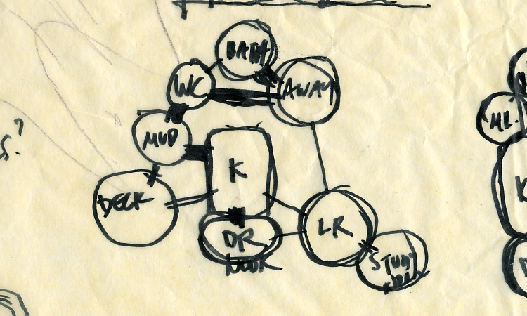
Ex: Architecture’s Bubble Diagram ͋
- 6
1st Diagram capturing flows
Notes:
Diagrams way of diagramming the basic relationships and connections between the rooms or functions of a building. Heavier lines means stronger or more direct connections. It doesn't necessarily translate directly to a floor plan, but it helps clarify which rooms need to be next to which other rooms. Above we have a first bubble diagram of the main floor of the (More) Affordable Green Home. It shows strong connections between the dining and kitchen, kitchen and mud room/laundry, living and kitchen and dining (all part of the great room). The study nook is connected to the living room. The away room is connected to the living room as well, but not as directly, since after all we want this to be "away." The WC and bathing rooms, on the other hand, need to be near both the mud room and the away room, since the away room will function as an occasional bedroom.

Slide 13
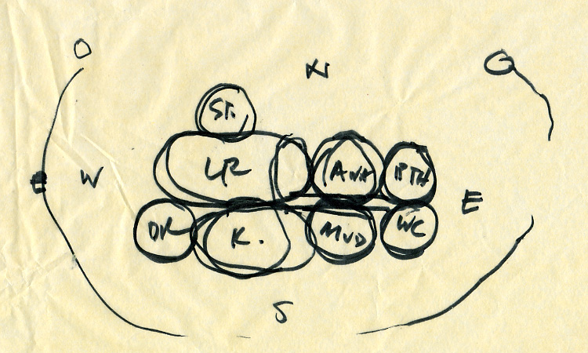
Ex: Architecture’s Bubble Diagram ͋
- 7
2nd Diagram rearranges blobs into a vague shape
Notes:
Diagrams way of diagramming the basic relationships and connections between the rooms or functions of a building. Heavier lines means stronger or more direct connections. It doesn't necessarily translate directly to a floor plan, but it helps clarify which rooms need to be next to which other rooms. Above we have a first bubble diagram of the main floor of the (More) Affordable Green Home. It shows strong connections between the dining and kitchen, kitchen and mud room/laundry, living and kitchen and dining (all part of the great room). The study nook is connected to the living room. The away room is connected to the living room as well, but not as directly, since after all we want this to be "away." The WC and bathing rooms, on the other hand, need to be near both the mud room and the away room, since the away room will function as an occasional bedroom.

Slide 14
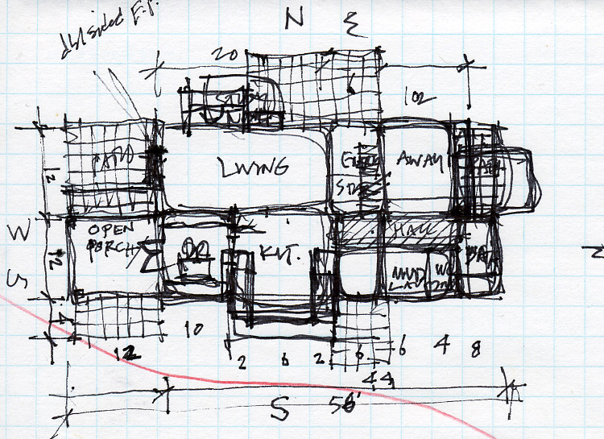
Ex: Architecture’s Bubble Diagram ͋
- 8
3rd Diagram attempts metric space allocation; looks at effects of arrangement on quality
Notes:
Diagrams way of diagramming the basic relationships and connections between the rooms or functions of a building. Heavier lines means stronger or more direct connections. It doesn't necessarily translate directly to a floor plan, but it helps clarify which rooms need to be next to which other rooms. Above we have a first bubble diagram of the main floor of the (More) Affordable Green Home. It shows strong connections between the dining and kitchen, kitchen and mud room/laundry, living and kitchen and dining (all part of the great room). The study nook is connected to the living room. The away room is connected to the living room as well, but not as directly, since after all we want this to be "away." The WC and bathing rooms, on the other hand, need to be near both the mud room and the away room, since the away room will function as an occasional bedroom.

Slide 15
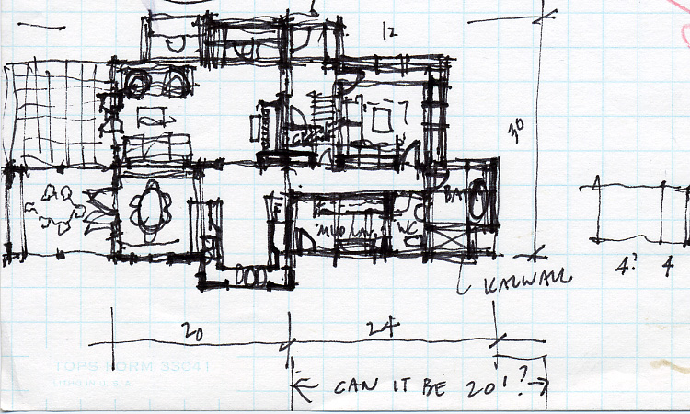
Ex: Architecture’s Bubble Diagram ͋
- 9
4rd Diagram further tries to resolve conflicts bet building and owner lot. Some dimensions do not work
Notes:
Diagrams way of diagramming the basic relationships and connections between the rooms or functions of a building. Heavier lines means stronger or more direct connections. It doesn't necessarily translate directly to a floor plan, but it helps clarify which rooms need to be next to which other rooms. Above we have a first bubble diagram of the main floor of the (More) Affordable Green Home. It shows strong connections between the dining and kitchen, kitchen and mud room/laundry, living and kitchen and dining (all part of the great room). The study nook is connected to the living room. The away room is connected to the living room as well, but not as directly, since after all we want this to be "away." The WC and bathing rooms, on the other hand, need to be near both the mud room and the away room, since the away room will function as an occasional bedroom.

Slide 16
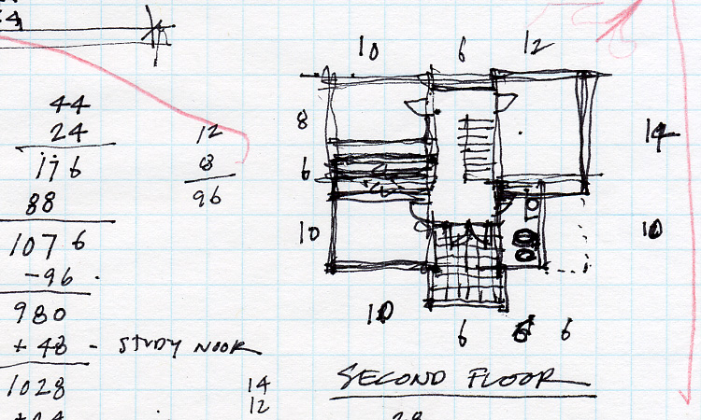
Ex: Architecture’s Bubble Diagram ͋
- 10
5th Diagram involves a whack at second floor
Notes:
Diagrams way of diagramming the basic relationships and connections between the rooms or functions of a building. Heavier lines means stronger or more direct connections. It doesn't necessarily translate directly to a floor plan, but it helps clarify which rooms need to be next to which other rooms. Above we have a first bubble diagram of the main floor of the (More) Affordable Green Home. It shows strong connections between the dining and kitchen, kitchen and mud room/laundry, living and kitchen and dining (all part of the great room). The study nook is connected to the living room. The away room is connected to the living room as well, but not as directly, since after all we want this to be "away." The WC and bathing rooms, on the other hand, need to be near both the mud room and the away room, since the away room will function as an occasional bedroom.

Slide 17
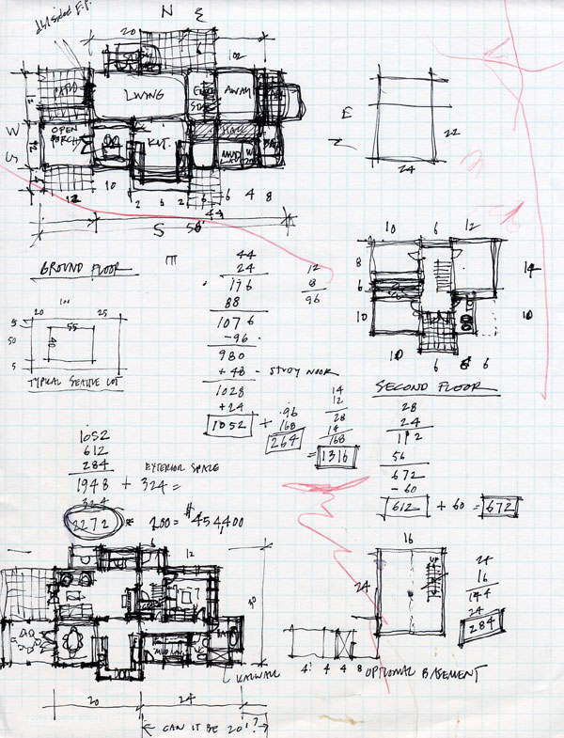
Ex: Architecture’s Bubble Diagram ͋
- 11
6th Diagram becomes increasing realistic;
Many calculations to establich feasibility, satisfaction of constraints, determine what spec’s to relax
Notes:
Diagrams way of diagramming the basic relationships and connections between the rooms or functions of a building. Heavier lines means stronger or more direct connections. It doesn't necessarily translate directly to a floor plan, but it helps clarify which rooms need to be next to which other rooms. Above we have a first bubble diagram of the main floor of the (More) Affordable Green Home. It shows strong connections between the dining and kitchen, kitchen and mud room/laundry, living and kitchen and dining (all part of the great room). The study nook is connected to the living room. The away room is connected to the living room as well, but not as directly, since after all we want this to be "away." The WC and bathing rooms, on the other hand, need to be near both the mud room and the away room, since the away room will function as an occasional bedroom.

Slide 19
What good interface principles |  | - 1
 | do we already know ?
Effective to use
Interesting, pleasing, attractive, inviting
Intuitive à la Alan Kay’s children
Organized, hierarchically structured, clean

Slide 20
What good interface principles |  | - 2
 | do we already know?
Help functions, Search, etc
Consistent form (aka “design integrity”)
Automatic assistance
Completions
Spelling

Slide 21
What good interface principles |  | - 3
 | do we already know?
Lead the user
Prompts
Indicate nature of any problem
No indication
Vague, misleading indication
Wrong indication (Latex)
Specific communication
Navigational aids: navi sys’s often huge

Slide 22
What good interface principles |  | - 4
 | do we already know?
Meaningful error msgs
Don’t send you elsewhere
Give useful data
Area of inadequate traditions
Multiple paths to a function
Keep it simple

Slide 23
What good interface principles |  | - 5
 | do we already know?
Gain user’s trust
Bottom up is probably most comfortable
Simple tasks should be simple
WYSIWYG – easy to get started
piano v violin
Notes:
We ended class on Bullet 2

Slide 24
Our history hurts us… - 1
Developed poor communications habits
Natural language terribly ambiguous
Meaning: “Mary had a little lamb”
Resources used 2B scarce
Other priorities, historically

Slide 25
Our history hurts us… - 2
Error Messages
Early computing: “Compiler error”
Even now: Sys Error EM732851
“Check Engine”
Error from wrong module: Latex
Confusing directions
400 S HOV Interchange on I15

Slide 26
Our history hurts us… - 2
Small road signs <example>

Slide 27
Our history hurts us: KE007 - 3
KE007
1 Sep 1983

Slide 28
Our history hurts us… KE007 - 4
Korean Airlines Flight 007
269 onboard, veered over Soviet airspace in Pacific, and was shot down
Pilot/Navigator keyed in numerical coordinates by hand for flight plan!

Slide 29
Our history hurts us… KE007 - 5
How about:
Automatic download?
Picking from a menu?
Symbolic names?
Confirmation playback?

Slide 30
Our history hurts us… KE007 - 6
How about:
Context check (like type-checking…)?
Pilot, run, time, plane, schedules, assignments, etc

Slide 31
Our history hurts us… KE007 - 7
How about:
Monitors, Alarms, Inhibitors?
Confirmation message?
Aviation tower communications
Telephone technical conversations
Parity checks?

Slide 32
Our history hurts us… - 8
Audi
Cars took off from a standing position
Driver error, claimed Audi…
Whose error was it?

Slide 33
Our history hurts us… - 9
NASA’s Mars Orbiter space probe
NASA’s Polar Lander Mars space probe

Slide 34
Our history hurts us… - 10
NASA space probe
Lost major mission over units mistake
JPL group worked in SI units
Colorado group worked in English units
Combining results led to bad numbers
Type checking issues?

Slide 35
Bookmark
Pick up here...

Slide 36
Culture -1
What does this sign mean?

Slide 37
Culture -2
What does this sign mean?

Slide 38
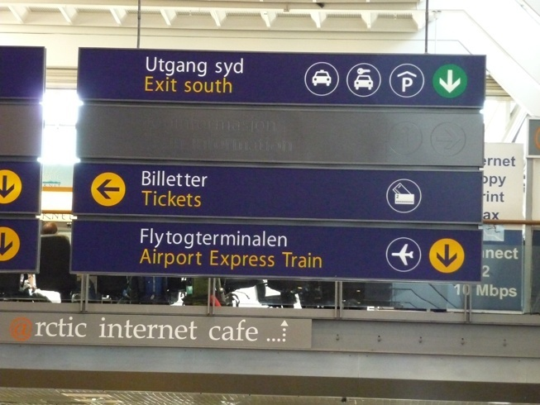
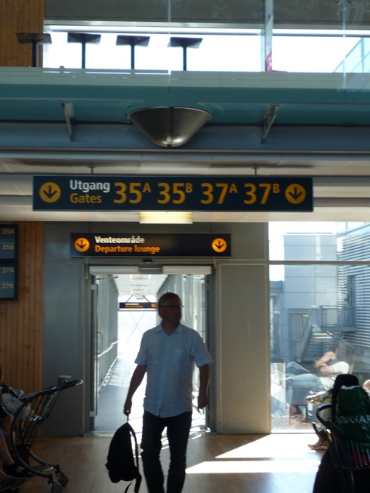
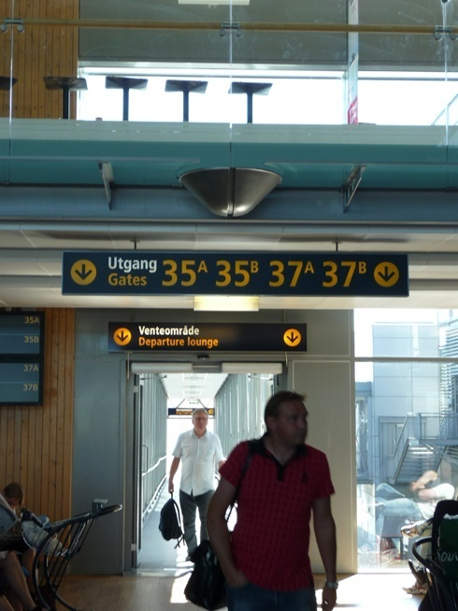
Culture - 3

Slide 39
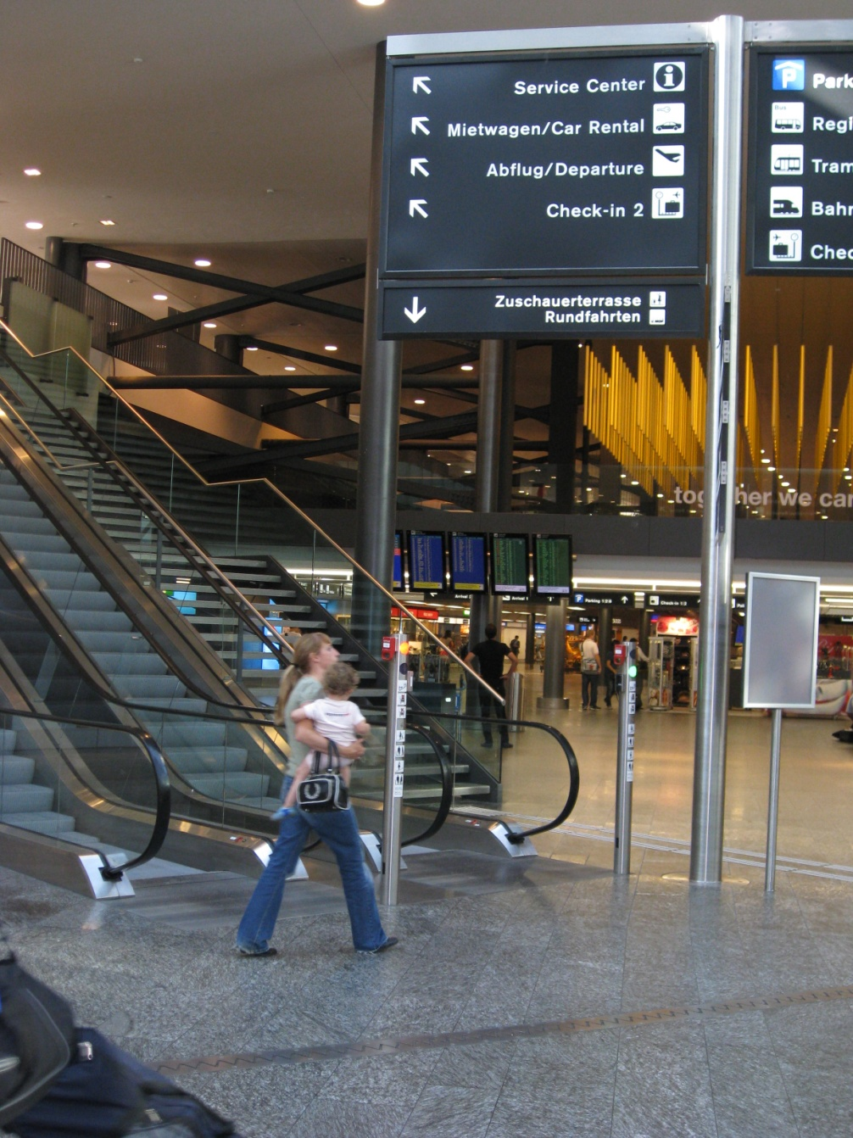
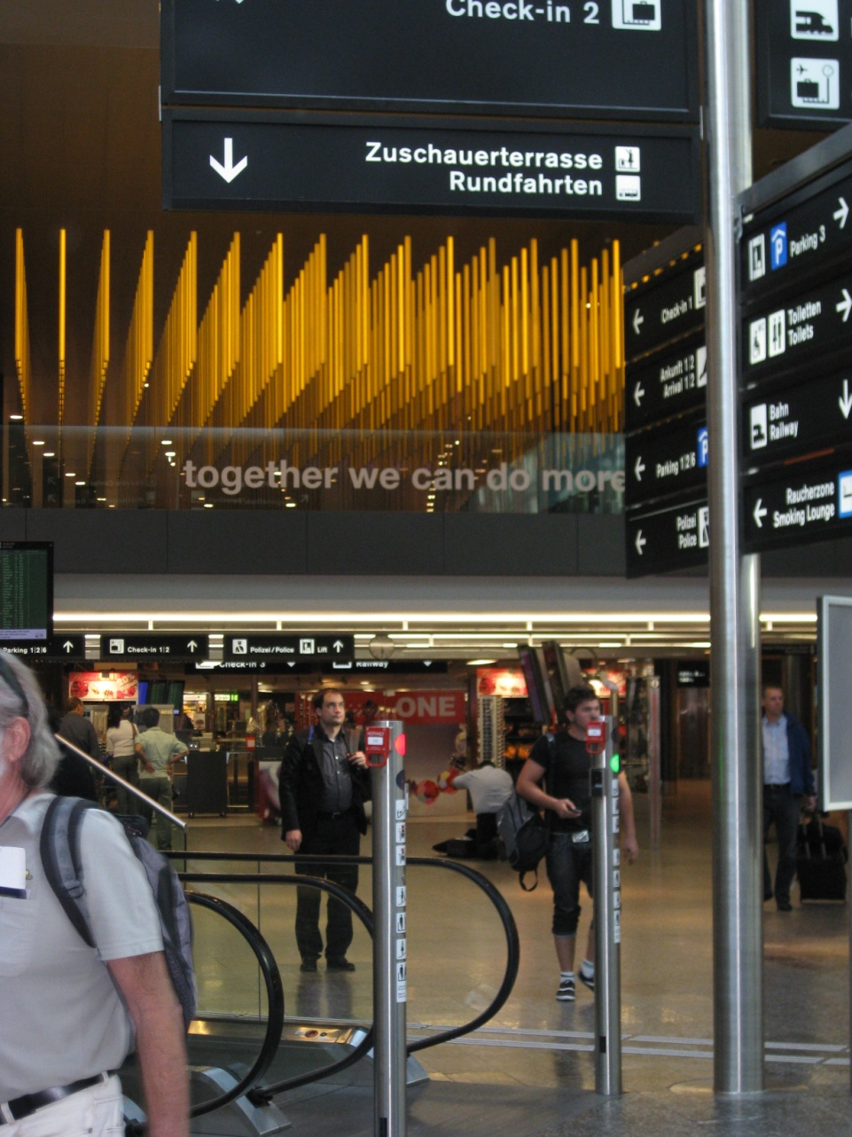
Culture - 3

Slide 40
Culture - 3

Slide 41
Culture - 4
Up is better than down
Religion, Dante, …
When we refer to ourselves
We point to our noses?
Our chests?
Point with index finger or hand ?

Slide 42
Critical Interfaces
Nuclear power plants: 1961 SL1 nuclear disaster
Interface had better be clear and foolproof
Airplane cockpit
Computer graphics has simplified controls, information
Power saw, laser indicator
TMI

Slide 43
Accessibility of Controls
Where is the interface?
Where is the emergency “Off” ?
Access causes:
Exposure to danger
Confusion
Loss of critical time
Distraction (John Denver’s plane crash)
Disorientation

Slide 44
Parameter Overload
Too many choices
What does a parameter (widget) do?
Which is the most important at this time?
Examples

Slide 45
Effect of Function: Examples
Water faucets in a sink
Manual gear shift: 4 on the floor
Chords on a guitar: hard!
Interface is dictated (confused) by needed function

Slide 46
Other Historical Examples
Books are essentially linear
Stories or communications needs are not
Hyper-text
Breaks the shackles of linear text stream
Digress as needed, desired

Slide 47
HCI is a Design Problem
Design is old subject
Well studied, rich traditions
Apply design methodologies to build better interfaces
We will look at this viewpoint

Slide 48
Important Operational Issues
Reliability
Availability
Security
Data integrity

Slide 49
Important Basics
Standardization across app’s
Apple did this first
Integration of packages and tools
Unix does this well
Consistency in actions, design style, terms, menus, color, fonts, etc
Portability across platforms
Less than advertised (Quicken, eg)

Slide 50
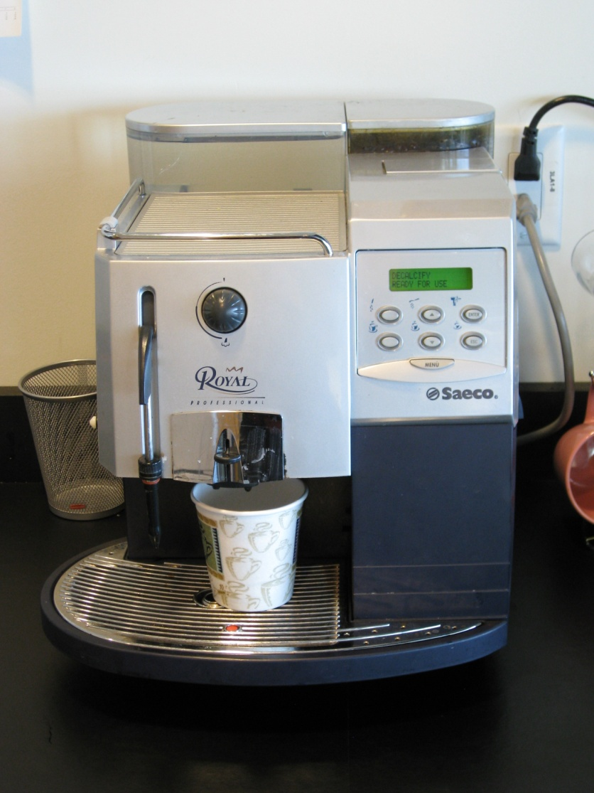
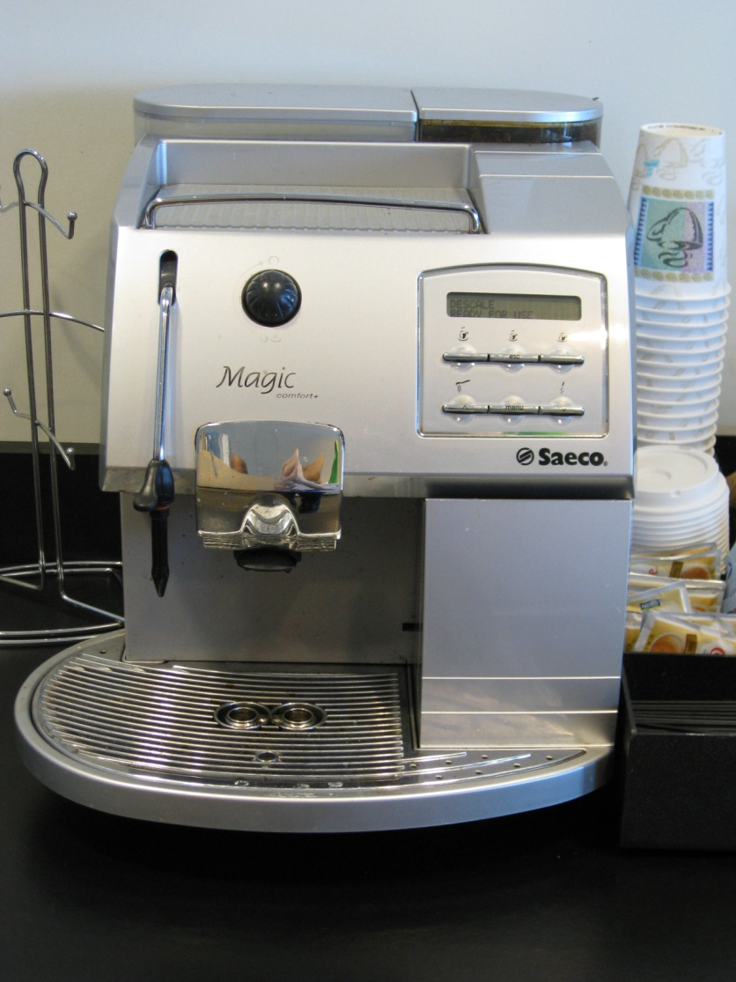

Slide 51
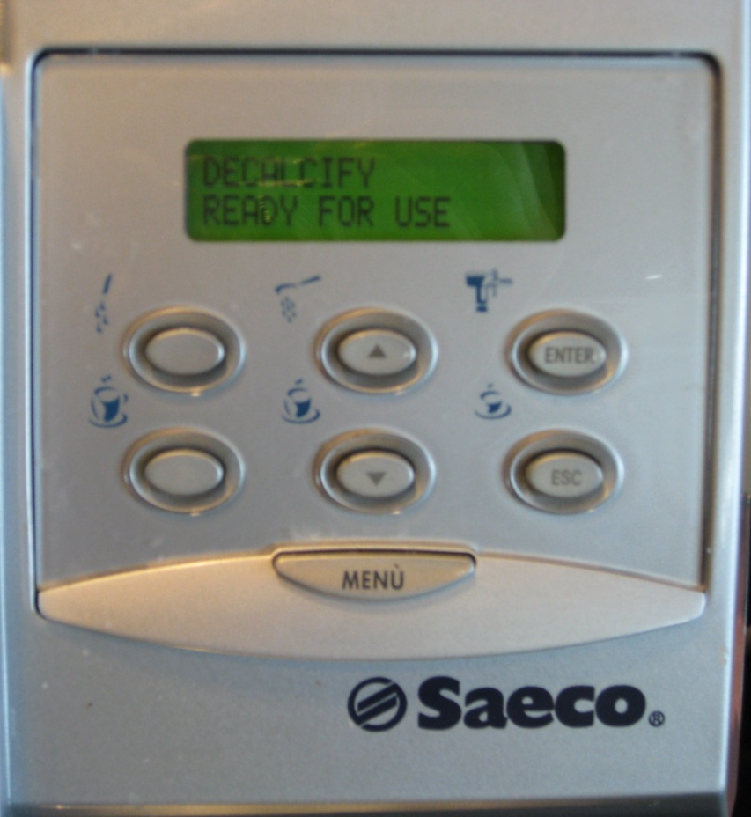
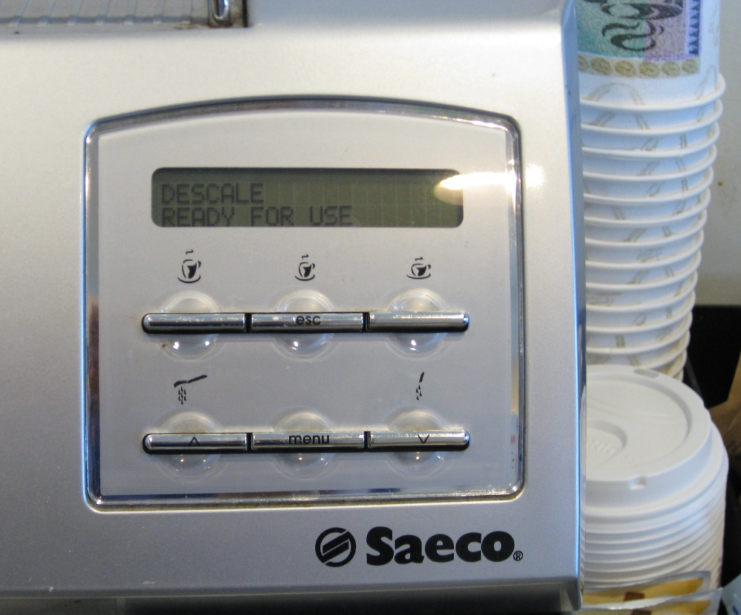
Inconsistent Placement
Full Cup Button

Slide 52
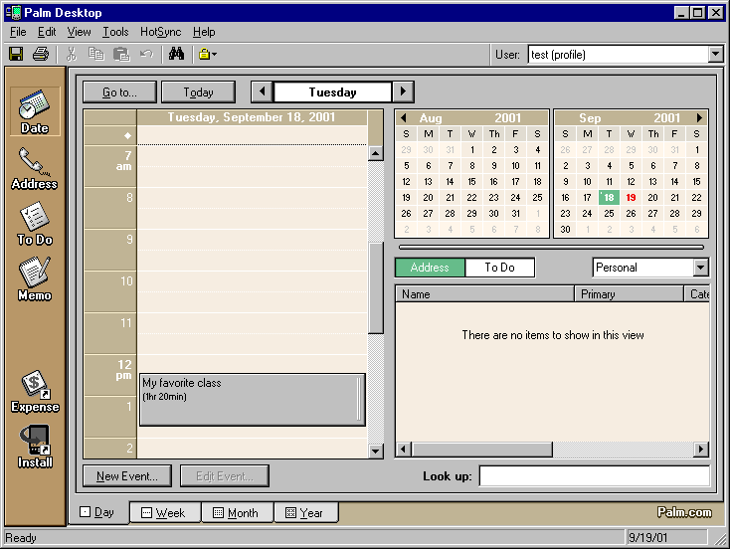
Palm Desktop Calendar

Slide 53
Palm Handheld Calendar

Slide 54
Important Stats -1
Time to learn
Speed of performance
How much coffee can one drink?
Rate of errors by users
“The user is always right!”

Slide 55
Important Stats -2
Retention over time
Do you have to start at square 1?
Subjective satisfaction
Do you like it (no explanation needed!)
Can you develop attachment for it?

Slide 56
Dramatically Different Needs - 1
Life-critical systems
Air traffic; nuclear reactors; cockpits; power utilities; emergency, military, medical, operations
Commercial
Banks, resv’s, inventory, point-of-sales (Hertz, Fedex,..), registration,..

Slide 57
Dramatically Different Needs - 2
Home, office, entertainment
Obvious needs
Exploratory, creative, cooperative systems
Bad interface (computer or otherwise) can destroy the process

Slide 58
Human Diversity
Ergonomics, anthropometry
Are you “average?”
Physical consideration
Height, stiffness, posture, shape, size of working area
IPD, head size, light sensitivity
Left-handedness

Slide 59
Cognitive Processes |  | - 1
 | (from Engineering Abstracts)
Short-term memory
Long-term memory
(Over 40 year old users…)
Problem solving
Decision making
Armageddon situations

Slide 60
Cognitive Processes (fr Eng Abs) |  | - 2
Attention and set (scope of concern)
ADHD, Ritalin population (5%)…
Search and scanning
Time perception

Slide 61
Perceptual & Motor Performance Factors (ibid) |  | - 1
Arousal and vigilance
Fatigue
Perceptual (mental) load
Knowledge of results
Monotony and boredom

Slide 62
Perceptual and Motor |  | - 2
 | Performance Factors (ibid)
Sensory deprivation
Sleep deprivation
New driving regulations
Medical interns/residents
Anxiety and fear
Isolation

Slide 63
Perceptual and Motor |  | - 3
 | Performance Factors (ibid)
Aging
Drugs and alcohol
Circadian rhythms

Slide 64
Gender Differences
Males and Females are different!
Aggressiveness comparisons
Learning environments
Positive v. Negative Reinforcement
Sensitivities
Much has been observed
Firm principles are scarce
Some research at Stanford

Slide 65
Carl Jung’s |  | - 1
 | Personality Differences
Extrovert v Introvert
Extroverts like action
Sensing v Intuition
Routine v (Discovering New)

Slide 66
Carl Jung’s Personality Differences | - 2
Perceptive v Judging
New situations v planning
Feeling v Thinking
Sensitive v logical

Slide 67
Recent Study Result …
Multi-tasking does not work!
Ergo, one should not:
Drive a car
Talk on a mobile phone
Q: Is driving a car a single task??
Q: Is playing piano a single task??
Q: Is speaking a foreign language??

Slide 68
Cultural & International Diversity - 1
Characters, numerals, special characters, diacriticals
Left-to-right v (right-to-left or vertical reading)
Date and time formats
International standards
Numeric and currency formats

Slide 69
Cultural & International Diversity - 2
Weights and measures
Telephones and addresses
Fixed v variable length
Names and titles
Mr., Ms., Mme, M., Dr.
SSNs, national IDs,
Capitalization and punctuation

Slide 70
Cultural & International Diversity - 3
Sorting sequences
Different alphabets
Icons, buttons, colors
Pluralization, grammar, spelling
Etiquette, policies, tone, formality, metaphors

Slide 71
Users with Disabilities
Can truly open doors
Man with ALS who uses head to type
Doing it well requires good client model
Designer challenges

Slide 72
Evaluating Interfaces - 1
Understanding of a practical problem
Lucid statement of a testable hypothesis
Manipulation of small number of independent variables
Measurement of specific dependent variables

Slide 73
Evaluating Interfaces - 2
Careful selection and assignment of subjects
Control for bias in subjects, procedures, and materials
Application of statistical tests
Interpretation of results, refinement of theory, and guidance for experimenters

Slide 74
Possible Research Directions - 1
Reduced anxiety of computers
Graceful evolution of systems
Specification and implementation of interaction
Direct manipulation

Slide 75
Possible Research Directions - 2
Input devices
Online assistance
Information exploration
Applications across platforms

Slide 76
End of Lecture Set 1 Preliminaries
End Lec Set 1

Slide 77
Our history hurts us… - 2a
Small road signs <example>
CircuitCalculator <example error msg>

Slide 78
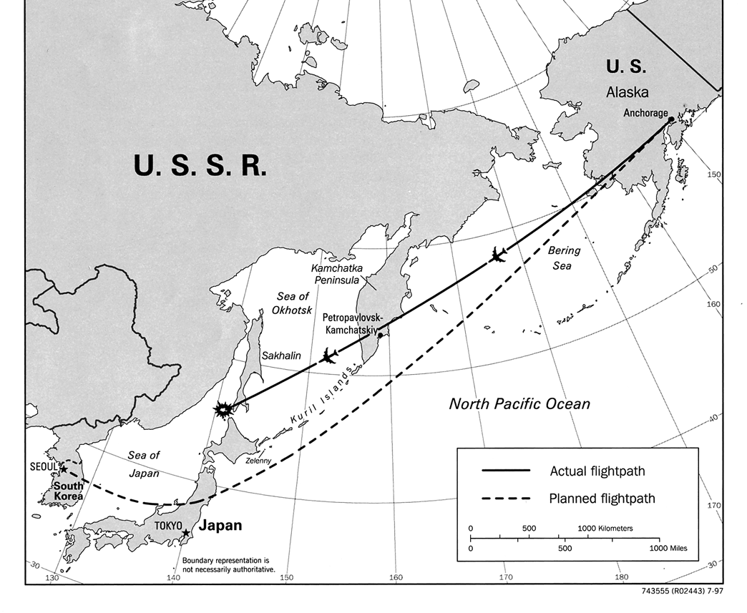
Our history hurts us: KE007 - 3a
from Wikipedia article: "Korean Airlines Flight 007"

