Slide 1
This Ain’t Rocket Science…
CS5540 HCI
Rich Riesenfeld
Fall 2007

Slide 2
2 Click Rule
Any item should be accessible in “2 clicks”
Problems
If there are many items, then the menu list gets VERY long!
If the tree is more structured, some items will get buried deeper
Can us dynamic structure (a la MS)

Slide 3
2 Click Rule
1
2
3
4
5
6
7
8

Slide 4
2 Click Rule
1
2
3
4
5
6
7
8

Slide 5
Modes
Modes – the same action means some different depending on the “mode”
Many examples abound
Modes are likely to be confusing

Slide 6
Modes
Digital alarm clock: Time v Alarm
Car stereo: Treble-Bass, Lt-Rt, Fr-Back
Emacs
Various finite state machines
Computers
Automobile controls
Remote for TV-CD-VCR

Slide 7
Modes
What mode am I in?
Should always be able to answer
Maintain analogies (parallelisms)
Similar actions produce analogous functions in various modes
Examples ??
This is a kind of consistency, really

Slide 8
Smart (non-dumb!) Interfaces
Who is the user?
Does the interface behave differently depending on the user?
Is it customizable?
Does it remember things?
Does it comes up in unexpected modes?

Slide 9
Smart (non-dumb!) Interfaces
Recall context from previous sessions?
Restore windows and pgms?
Allow easy return to “state” ?
Tactfully, alert against and resist nonsense inputs
Not allowed to do that … maybe you want to do this…

Slide 10
Smart (non-dumb!) Interfaces
Does it prompt? Anticipate?
Does it annoy, get in the way, give unhelpful, distracting msg’s? (paperclip)
The user’s efforts should be respected !
Offer typical choices?
Do a GOOD MS Paperclip!

Slide 11
Smart (non-dumb!) Interfaces
Does it sense and react to the environment?
Dim lights when light is low?
“Talk” louder when environment is noisy.
Fast and slow digital counters, etc.
Generate resistance to mistakes
Avoiding multiple clicks… (my office phone)
Stuff like that…

Slide 12
Smart (non-dumb!) Interfaces
Be responsive to inputs!
Departure date is AFTER arrv date, so advance it on input
Present a good choice for first guess. Today’s date, not 1 Jan, etc..
Other examples??

Slide 13
Smart (non-dumb!) Interfaces
Good defaults
Nonsmoking hotel room
Aisle seat, when available
Table apart from noisy group
Profiles, histories, data gathering
“Having your usual, madam?”
Quick select, speed dialing,
Don’t require repeated input of same info

Slide 14
Smart (non-dumb!) Interfaces
Assist with available “knowledge”
Spell checker, style checker
Color choices
Formats, templates, etc
Style critique
Don’t be lazy; pamper the user.

Slide 15
Smart (non-dumb!) Interfaces
Assist with “knowledge”
Pharmacy: patient drug interactions
Automobile guides: Neverlost
“Hey, my map says that this is a one-way. Achtung!” – Why doesn’t it do this?
Cannot lock key in ignition, etc.
Cannot leave car in Drive
Others?

Slide 16
Smart (non-dumb!) Interfaces
Narrow choices: Car Radio, eg
Scan for next
Jazz, Country, News, Sports, Spanish
Restaurants by locale, type, cost, etc
Movies by genre, and the like
Action, Drama, Documentary, Foreign, etc
Local Google Search

Slide 17
Smart (non-dumb!) Interfaces
UI should TRY to figure out problem, and try to solve it
Too easy to just complain, then
Core dump
Bail
Force user to start process over

Slide 18
Smart (non-dumb!) Interfaces
UI should TRY to figure out problem, and try to solve it
It may know the problem, and be able to fix it, or guide the user to easily fix it
Matching parens, eg
It looks as though… May I fix this?
Use “back pointers” to maintain correctness. Filters and mailboxes in Eudora. Hey!

Slide 19
Smart (non-dumb!) Interfaces
Guide user through tasks
What next?
Where am I in the grand scheme?
Does questionnaire tell you how much left?
Should I quickly finish, or break here?
Offer good defaults
Give stats on choices
90% of users do this ->

Slide 20
Smart (non-dumb!) Interfaces
Example – 4 wheel steering
Slow behavior (radical turns)
Fast behavior (gentle turns)
Forward v. Backward ??
Automatic trans, another example
Using context for smart, autonomous behavior
Anti-skid, anti-lock, etc.
Takes control, and does what is needed

Slide 21
Smart (non-dumb!) Interfaces
Be responsive to inputs!
Departure date is AFTER arrv date, so advance it on input
Present a good choice for first guess. Today’s date, not 1 Jan, etc..
Other examples??

Slide 22
Smart (non-dumb!) Interfaces
Good defaults
Nonsmoking hotel room
Aisle seat, when available
Table apart from noisy group
Profiles, histories, data gathering
“Having your usual, madam?”
Quick select, speed dialing,
Don’t require repeated input of same info

Slide 23
Smart (non-dumb!) Interfaces
Assist with available “knowledge”
Spell checker, style checker
Color choices
Formats, templates, etc
Style critique
Don’t be lazy; pamper the user.

Slide 24
Smart (non-dumb!) Interfaces
Assist with “knowledge”
Pharmacy: patient drug interactions
Automobile guides: Neverlost
“Hey, my map says that this is a one-way. Achtung!” – Why doesn’t it do this?
Cannot lock key in ignition, etc.
Cannot leave car in Drive
Others?

Slide 25
Smart (non-dumb!) Interfaces
Narrow choices: Car Radio, eg
Scan for next
Jazz, Country, News, Sports, Spanish
Restaurants by locale, type, cost, etc
Movies by genre, and the like
Action, Drama, Documentary, Foreign, etc
Local Google Search

Slide 26
Smart (non-dumb!) Interfaces
Example – 4 wheel steering
Slow behavior (radical turns)
Fast behavior (gentle turns)
Forward v. Backward ??
Automatic trans, another example
Using context for smart, autonomous behavior
Anti-skid, anti-lock, etc.
Takes control, and does what is needed

Slide 27
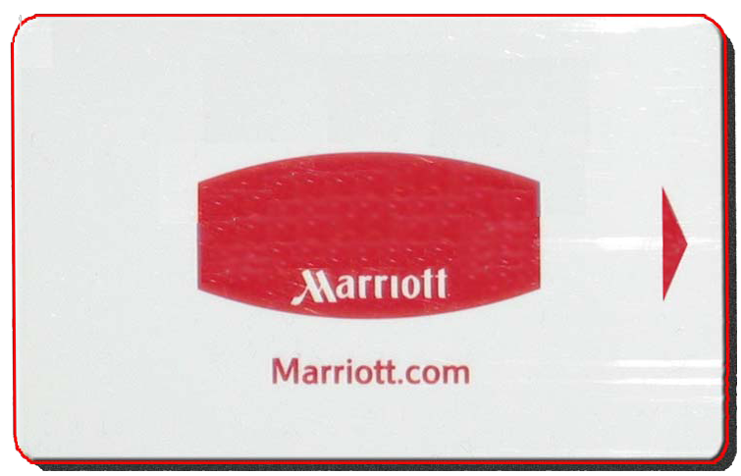
Standard Card Lock

Slide 28
Delayed Card Lock
Locks automatically after 2 min
Locks immediately if done manually

Slide 29
4 wheel steering
2-wheel steering
4-wheel
Low speed
4-wheel
High speed

Slide 30
2 wheel steering – all speeds

Slide 31
2 wheel steering – all speeds

Slide 32
4 wheel steering – low speed

Slide 33
4 wheel steering – low speed

Slide 34
4 wheel steering – low speed

Slide 35
4 wheel steering – high speed

Slide 36
Smart (non-dumb!) Interfaces
Security
When to help with password?
Providing info to wrong user?
How prudent, how circumspect is appropriate?
Video game, medical records, replace passport, info on grades, etc.

Slide 37
Smart (non-dumb!) Interfaces
UI should act as an assistant, or even an associate
Know the user: I like coffee in the morning
Watch activities, learn, remember
Help out: special terms, abbrev’s, etc
Guard against mistakes: force feed-back
Offer comfortable advice and assistance
“Think along. Know the art of helping!

Slide 38
Smart (non-dumb!) Interfaces
UI should act as an assistant
Think along, understand what is going on
Be friendly, not demeaning
Communicate in effective, straightforward terms, not “geekspeak”
Unobtrusively refer to explanations (clickable, etc) for technical items, background

Slide 39
Smart (non-dumb!) Interfaces
Beaucoup sensors
Temp, pressure, cameras, gaze, etc., etc.,
Beaucoup processors
Ids, DBs, agents, …
Continuous, immersive involvement

Slide 40
Smart (non-dumb!) Interfaces
Speech input
Talk to UI
UI talks to User
Shneiderman doubts its potential, however
Gestures

Slide 41
Gestures Studies
Following Gesture material from:
Hand Centered Studies of Human Movement Project, School of Kinesiology, Simon Fraser University, February 1996

Slide 42
Gestures-1
Praying (two flat hands up together)
Begging (flat hand)
Expressing anger (raising a fist)
Derogation (middle finger up)
Accusation (index pointing)
Live or die decisions in the Roman amphitheater (thumb up/down)

Slide 43
Gestures-2
Hitch hiking (thumb up, hand moving sideways)
Legal and business transactions (handshake, judge hammering)
Waving and saluting
Counting (fingers and/or hand)
Pointing to real and abstract objects and concepts (index, hand)

Slide 44
Gestures-3
Conducting an orchestra (variety of both gestures with arms and body)
Traffic control of cars and airplanes (hands flat pointing or moving)
Shaping of imagined objects (hands tracing out curves and shapes)
Martial arts, fighting (variety of movements of arms and body)

Slide 45
Gestures-4
Dance (Balinese dancing)
Gesturing by singers (hand and body movements)
Stock exchange operations (various hand shapes)
Affective gestures (hand touching)
Rejective (index up moving left & right) / appreciative (hand clapping) gestures

Slide 46
Gestures-5
Game playing (hand signs to communicate with partner in card games)
Game scoring (cricket, basketball, soccer, rugby, football)
Dinner table actions (commanding waiter to refill wine glass)
Positioning of real (remote or close) Control Panel operations (mousing, steering a vehicle)

Slide 47
Gestures-6
Moving, touching and interacting with objects
Silent and non-verbal communication (shrugging, holding one's own earlobe, scratching)
“Italianate" gestures (two hands open shaking)

Slide 48
Gestures-7
Mimicry and pantomime (actions and objects are depicted with hand/body movements)
sign language (a complete linguistic communication system)
Mimicry and pantomime (actions and objects are depicted with hand/body movements)

Slide 49
Gestures-8
Shimmering hand (maybe, maybe not)
Sign language (a complete linguistic communication system)
Aircraft carrier landings
Dog training
Gambling signals at a casino

Slide 50
Pictograms - 1

Slide 51
Pictograms - 2

Slide 52
Pictograms - 3

Slide 53
Pictograms -4
Pictgram standard
MAYON OF LOND ON

Slide 54
Pictograms - 5
Pictogram standard
MAYON OF LOND ON

Slide 55
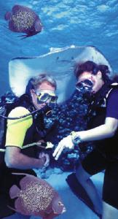
Special Need Group: Divers

Slide 56
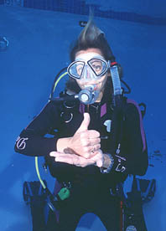
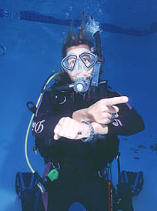
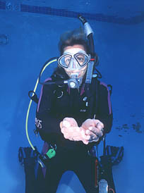
“Which direction?”
“Help”
“Boat"

Slide 57
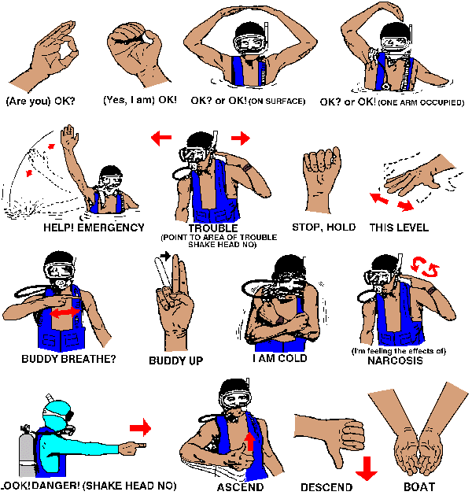
Underwater Communications and Hand Signals - 1

Slide 58
Underwater Communications and Hand Signals - 2

Slide 59
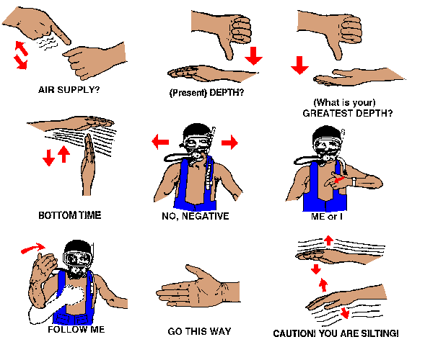
Underwater Communications and Hand Signals - 3

Slide 60
ARFF Emergency Hand Signals - 1
Aircraft Rescue and Fire Fighting (ARFF) Communications

Slide 61
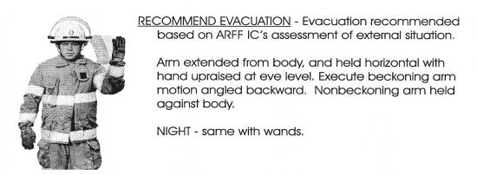
Recommend Evacuation
ARFF Emergency Hand Signals - 2

Slide 62
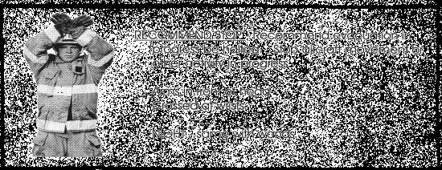
Recommend Stop
ARFF Emergency Hand Signals - 3

Slide 63
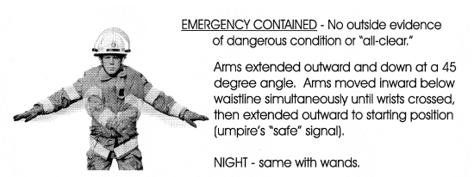
ARFF Emergency Hand Signals - 4
Emergency Contained

Slide 64
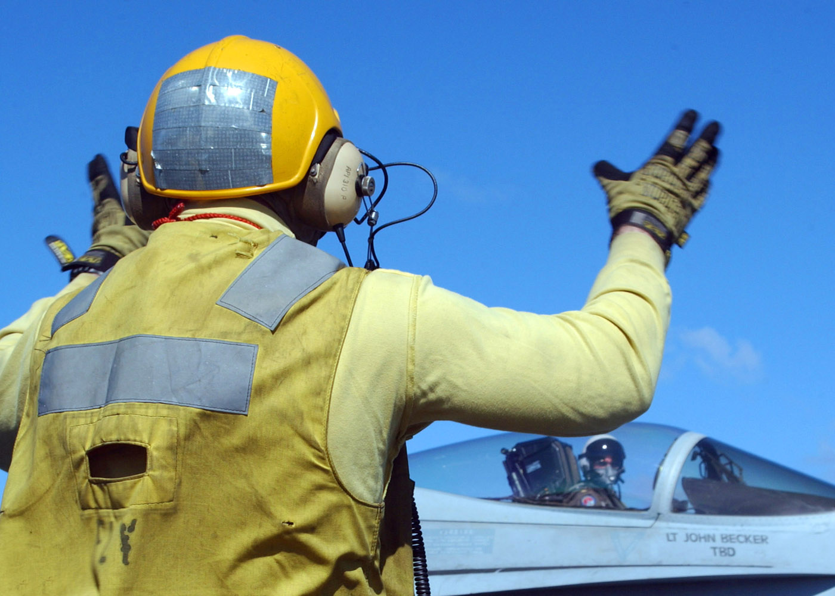
Plane Director Uses Hand Signals to Give Directions to Pilots - 1

Slide 65
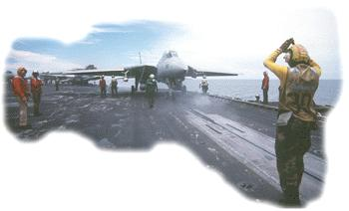
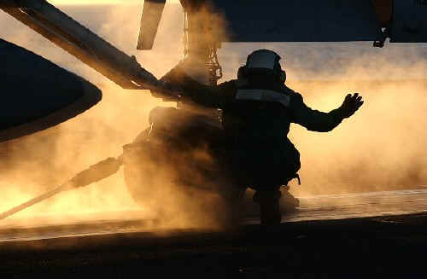
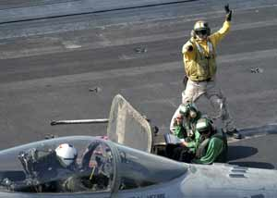
Plane Director Using Hand Signals - 2

Slide 66
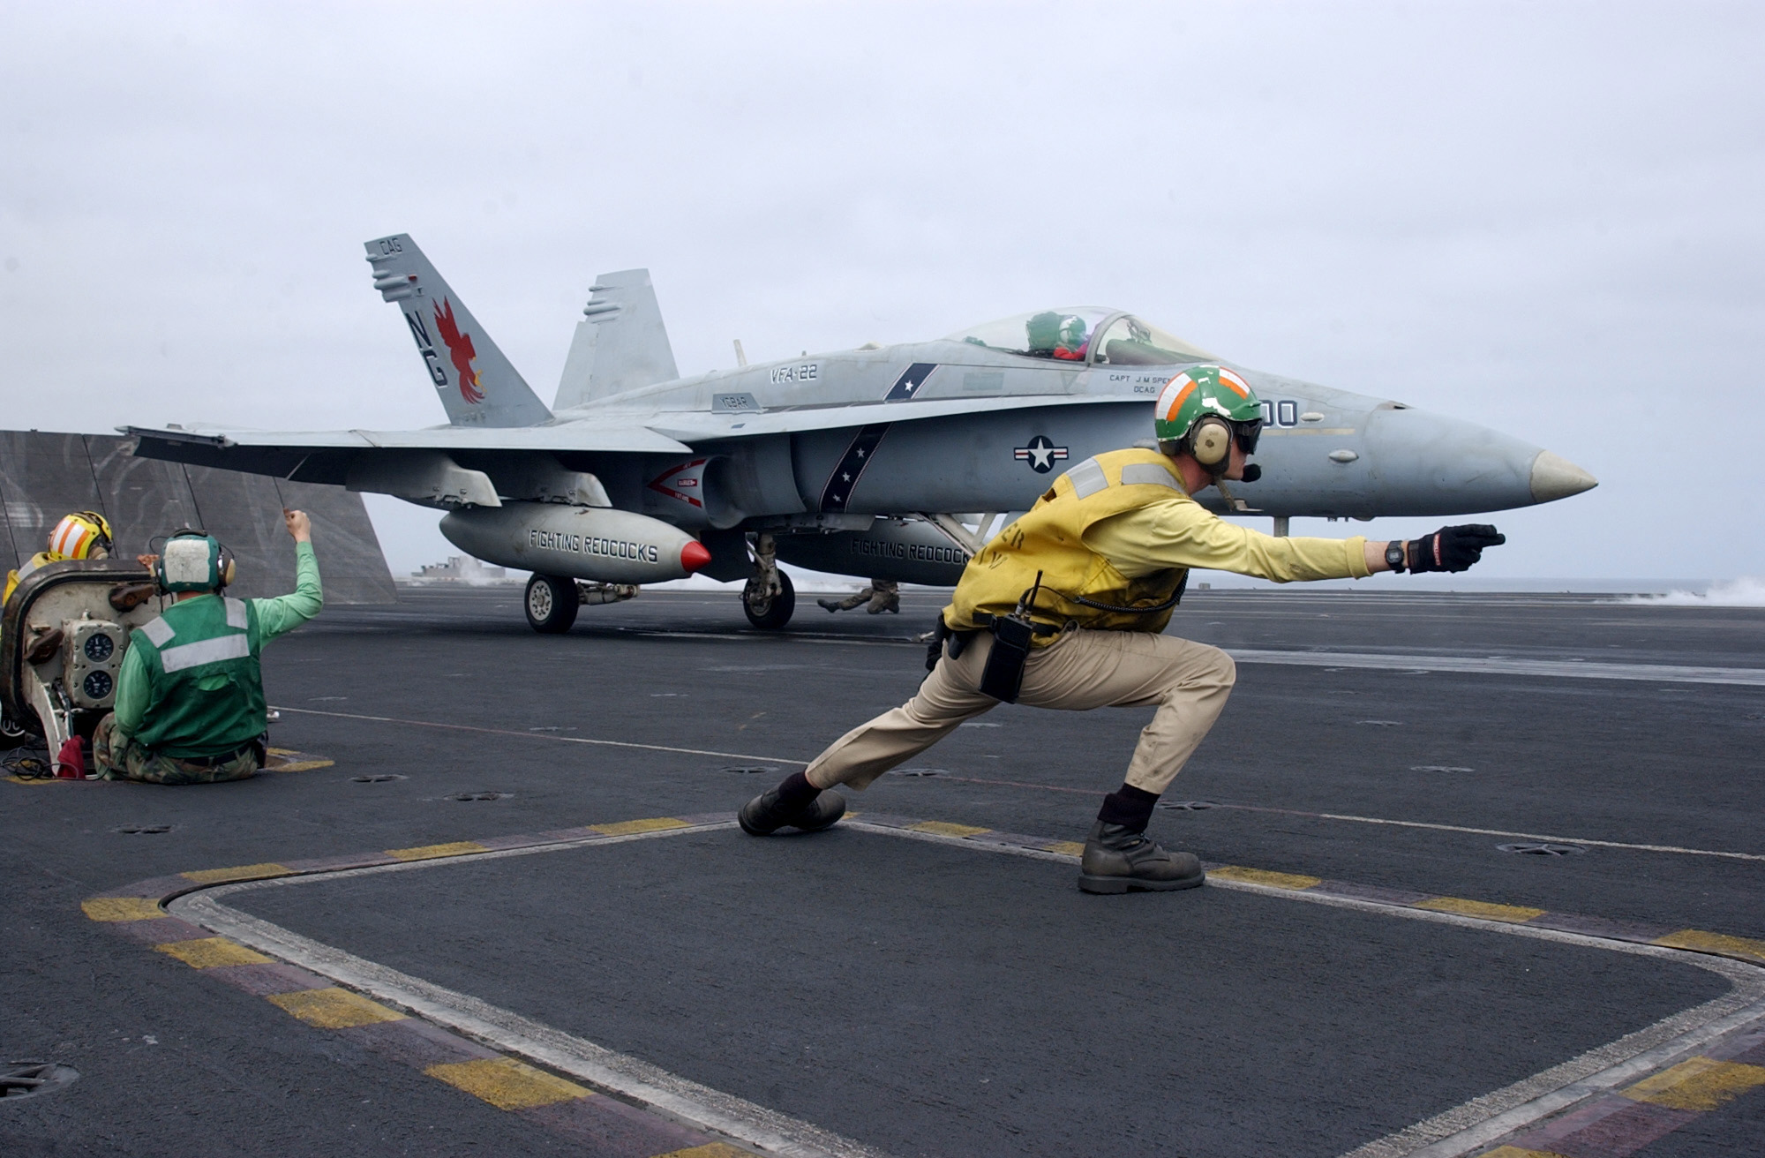
Ready for Launch
Plane Director Using Hand Signals

Slide 67
Complete Final Turn Up (Instructions to pilot)
Brakes off or Brakes On
Suspend Catapult Operation
All Clear or Affirmative
(Fist clenched = Suspend Operation)

Slide 68
The pilot salutes when ready to launch. The Plane Director returns salute to acknowledge pilot's readiness.
Lower Launch Bar or Raise Launch Bar
I have control. (Taking over from previous controller)
Hang Fire (Pilot to hold on until further instructions)

Slide 69
Smart (non-dumb!) Interfaces
Eliminate the 3-handed interface
Keyboard + mouse (impossible situation, really)
2 hands plus voice?
Another kind of input?

Slide 70
Topics for Future
Ergonomics
Psychological aspect,
Smart interfaces / AI
Building interfaces
Designing interfaces
Testing
Throwing out inadequate ones

Slide 71
Conclusions
This is not so easy to figure out
This IS hard to do
Take much work, actually
UI is expensive, labor intensive
Have not begun to talk about real AI, just “HI”!

Slide 72
End
This Ain’t Rocket Science…

